Slide 1





A Case Study of “Gang of Four” (GoF) Patterns: Part 1
Douglas C. Schmidt
d.schmidt@vanderbilt.edu
www.dre.vanderbilt.edu/~schmidt
Professor of Computer Science
Institute for Software Integrated Systems Vanderbilt University Nashville, Tennessee, USA

Slide 2
Topics Covered in this Part of the Module
Describe the object-oriented (OO) expression tree case study
Binary
Nodes
Unary
Node
Leaf
Nodes

Slide 3
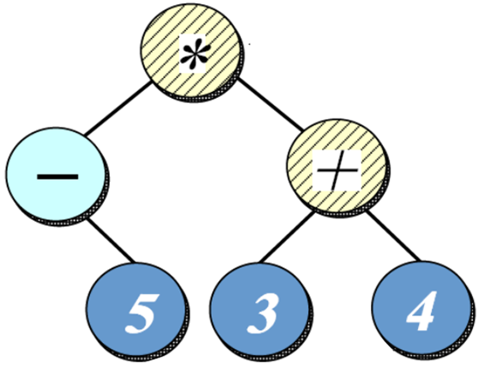
Case Study: Expression Tree Processing App
Goals
Develop an OO expression tree processing app using patterns & frameworks
Design Problem | Pattern(s)
Extensible expression tree structure | Composite
Encapsulating variability & simplifying memory management | Bridge
Parsing expressions & creating expression tree | Interpreter & Builder
Extensible expression tree operations | Iterator & Visitor
Implementing STL iterator semantics | Prototype
Consolidating user operations | Command
Consolidating creation of variabilities for commands, iterators, etc. | Abstract Factory & Factory Method
Ensuring correct protocol for commands | State
Structuring application event flow | Reactor
Supporting multiple operation modes | Template Method & Strategy
Centralizing access to global resources | Singleton
Eliminating loops via the STL std::for_each() algorithm | Adapter
Expression trees are used to remove ambiguity in algebraic expressions

Slide 4
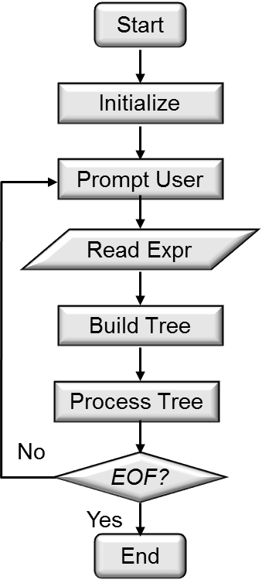
Case Study: Expression Tree Processing App
Goals
Develop an OO expression tree processing app using patterns & frameworks
Compare/contrast non-object-oriented & object-oriented approaches
Expression_Tree
Component_Node
Composite_
Unary_Node
Leaf_Node
Tree Node
1
Composite_Binary _Node
Composite_Negate _Node
0|1|2
Composite_
Add_Node
Composite_
Subtract_Node
Composite_
Multiply_Node
Composite_
Divide_Node
Despite decades of OO emphasis, algorithmic decomposition is still common

Slide 5
Case Study: Expression Tree Processing App
Goals
Develop an OO expression tree processing app using patterns & frameworks
Compare/contrast non-object-oriented & object-oriented approaches
Demonstrate Scope, Commonality, & Variability (SCV) analysis in the context of a concrete example
SCV is a systematic software reuse method
Binary
Nodes
Unary
Node
Leaf
Nodes
www.cs.iastate.edu/~cs309/references/CoplienHoffmanWeiss_CommonalityVariability.pdf

Slide 6
Case Study: Expression Tree Processing App
Goals
Develop an OO expression tree processing app using patterns & frameworks
Compare/contrast non- object-oriented & object- oriented approaches
Demonstrate Scope, Commonality, & Variability (SCV) analysis in the context of a concrete example
Illustrate how pattern- oriented OO frameworks can be implemented in C++ & Java
Expression_Tree expr_tree = …; Print_Visitor print_visitor;
for (auto &iter : expr_tree)
iter.accept(print_visitor);
ExpressionTree exprTree = …;
ETVisitor printVisitor = new PrintVisitor();
for (ComponentNode node : exprTree)
node.accept(printVisitor);
C++11 range-based for loop
Java for-each loop

Slide 7
Overview of Expression Tree Processing App
Expression trees consist of nodes containing operators & operands
Binary
Nodes
See en.wikipedia.org/wiki/Binary_expression_tree for expression tree info

Slide 8
Overview of Expression Tree Processing App
Expression trees consist of nodes containing operators & operands
Operators are interior nodes in the tree
i.e., binary & unary nodes
Binary
Nodes
Unary
Node

Slide 9
Overview of Expression Tree Processing App
Expression trees consist of nodes containing operators & operands
Operators are interior nodes in the tree
i.e., binary & unary nodes
Operands are exterior nodes in the tree
i.e., leaf nodes
Binary
Nodes
Unary
Node
Leaf
Nodes

Slide 10
Overview of Expression Tree Processing App
Expression trees consist of nodes containing operators & operands
Operators have different precedence levels, different associativities, & different arities, e.g.:
Binary
Operators
Unary
Operator
Leaf
Nodes

Slide 11
Overview of Expression Tree Processing App
Expression trees consist of nodes containing operators & operands
Operators have different precedence levels, different associativities, & different arities, e.g.:
The multiplication operator has two arguments, whereas unary minus operator has only one
Binary
Operators
Unary
Operator
Leaf
Nodes

Slide 12
Overview of Expression Tree Processing App
Expression trees consist of nodes containing operators & operands
Operators have different precedence levels, different associativities, & different arities, e.g.:
The multiplication operator has two arguments, whereas unary minus operator has only one
Operator locations in the tree unambiguously designate precedence
Binary
Operators
Unary
Operator
Leaf
Nodes

Slide 13
Overview of Expression Tree Processing App
Expression trees consist of nodes containing operators & operands
Operators have different precedence levels, different associativities, & different arities
Operands can be integers, doubles, variables, etc.
We'll just handle integers in this example, though it can easily be extended
Binary
Operators
Unary
Operator
Integer Operands

Slide 14
Overview of Expression Tree Processing App
Trees may be “evaluated” via different traversal orders, e.g.,
“in-order iterator” = -5*(3+4)
“pre-order iterator” = *-5+34
“post-order iterator” = 5-34+*
“level-order iterator” = *-+534
See en.wikipedia.org/wiki/Binary_expression_tree#Traversal for more info

Slide 15
Overview of Expression Tree Processing App
Trees may be “evaluated” via different traversal orders, e.g.,
“in-order iterator” = -5*(3+4)
“pre-order iterator” = *-5+34
“post-order iterator” = 5-34+*
“level-order iterator” = *-+534
The evaluation step may perform various actions, e.g.:
Print contents of expression tree
Return the “value" of the expression tree
Perform semantic analysis & optimization
Generate code
etc.
S = [5] push(node.item())
S = [-5] push(-pop())
S = [-5, 3] push(node.item())
S = [-5, 3, 4] push(node.item())
S = [-5, 7] push(pop()+pop())
S = [-35] push(pop()*pop())

Slide 16
Summary
The expression tree processing app can be run in multiple modes, e.g.:
“Succinct mode”
“Verbose mode”
% tree-traversal -v
format [in-order]
expr [expression]
print [in-order|pre-order|post- order|level-order]
eval [post-order]
quit
> format in-order
> expr 1+4*3/2
> print post-order
143*2/+
> eval post-order
7
> quit
% tree-traversal
> 1+4*3/2
7
> (8/4) * 3 + 1
7
^D

Slide 17
A Case Study of “Gang of Four” (GoF) Patterns: Part 2
Douglas C. Schmidt
d.schmidt@vanderbilt.edu
www.dre.vanderbilt.edu/~schmidt
Professor of Computer Science
Institute for Software Integrated Systems Vanderbilt University Nashville, Tennessee, USA

Slide 18
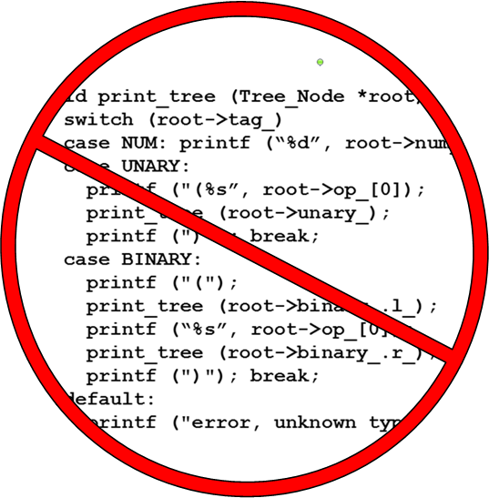
Topics Covered in this Part of the Module
Describe the object-oriented (OO) expression tree case study
Evaluate the limitations with algorithmic design techniques
Start
Initialize
Prompt User
Read Expr
Build Tree
Process Tree
No
EOF?
Yes
End

Slide 19
How Not to Design an Expression Tree Application
Apply algorithmic decomposition
Top-down design based on the actions performed by the system
Start
Initialize
Prompt User
A
Read Expr
Build Tree
Process Tree
B
No
EOF?
Yes
End

Slide 20
How Not to Design an Expression Tree Application
Apply algorithmic decomposition
Top-down design based on the actions performed by the system
Generally follows a “divide & conquer” strategy based on the actions
i.e., general actions are iteratively/recursively decomposed into more specific ones
Start
A
Initialize
Verbose?
Yes
No
Prompt User
Verbose Prompt
A
Succinct Prompt
Read Expr
Build Tree
B
Print?
Yes
Process Tree
No
Print Tree
B
Yes
Eval?
No
EOF?
No
Eval Tree
Yes
End

Slide 21
How Not to Design an Expression Tree Application
Apply algorithmic decomposition
Top-down design based on the actions performed by the system
Generally follows a “divide & conquer” strategy based on the actions
i.e., general actions are iteratively/recursively decomposed into more specific ones
Primary design components correspond to processing steps in execution sequence
e.g., C functions
typedef struct Tree_Node {
...
} Tree_Node;
void prompt_user(int verbose);
char *read_expr(FILE *fp);
Tree_Node *build_tree (const char *expr);
void process_tree (Tree_Node *root, FILE *fp);
void eval_tree
(Tree_Node *root, FILE *fp);
void print_tree
(Tree_Node *root, FILE *fp);
...
We’ll explore this shortly
We’ll explore this shortly

Slide 22
Algorithmic Decomposition of Expression Tree
A typical algorithmic decomposition for implementing expression trees would use a C struct/union to represent the main data structure
typedef struct Tree_Node {
enum { NUM, UNARY, BINARY } tag_;
short use_;
union {
char op_[2];
int num_;
} o;
#define num_ o.num_
#define op_ o.op_
union {
struct Tree_Node *unary_;
struct { struct Tree_Node *l_,
*r_;} binary_;
} c;
#define unary_ c.unary_
#define binary_ c.binary_
} Tree_Node;
Type tag
Reference count
Node value
Node child(ren)

Slide 23
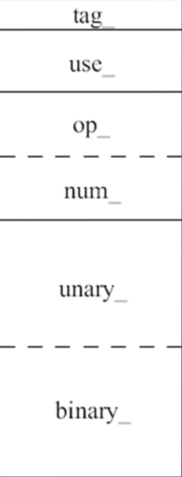
Algorithmic Decomposition of Expression Tree
A typical algorithmic decomposition for implementing expression trees would use a C struct/union to represent the main data structure
typedef struct Tree_Node {
enum { NUM, UNARY, BINARY } tag_;
short use_;
union {
char op_[2];
int num_;
} o;
#define num_ o.num_
#define op_ o.op_
union {
struct Tree_Node *unary_;
struct { struct Tree_Node *l_,
*r_;} binary_;
} c;
#define unary_ c.unary_
#define binary_ c.binary_
} Tree_Node;
Memory Layout
“Class” Relationships
tag_
1
Tree Node
use_
op_
0|1|2
num_
unary_
binary_

Slide 24
Algorithmic Decomposition of Expression Tree
A typical algorithmic decomposition uses a switch statement & a recursive function to build & evaluate a tree, e.g.:
void print_tree(Tree_Node *root, FILE *fp) {
switch(root->tag_) {
case NUM: fprintf(fp, "%d", root->num_); break;
case UNARY:
fprintf(fp, "(%s", root->op_[0]);
print_tree(root->unary_, fp);
fprintf(fp, ")"); break;
case BINARY:
fprintf(fp, "(");
print_tree(root->binary_.l_, fp);
fprintf(fp, "%s", root->op_[0]);
print_tree(root->binary_.r_, fp);
fprintf(fp, ")"); break;
...
}
Switch on type tag

Slide 25
Algorithmic Decomposition of Expression Tree
A typical algorithmic decomposition uses a switch statement & a recursive function to build & evaluate a tree, e.g.:
void print_tree(Tree_Node *root, FILE *fp) {
switch(root->tag_) {
case NUM: fprintf(fp, "%d", root->num_); break;
case UNARY:
fprintf(fp, "(%s", root->op_[0]);
print_tree(root->unary_, fp);
fprintf(fp, ")"); break;
case BINARY:
fprintf(fp, "(");
print_tree(root->binary_.l_, fp);
fprintf(fp, "%s", root->op_[0]);
print_tree(root->binary_.r_, fp);
fprintf(fp, ")"); break;
...
}

Slide 26
Algorithmic Decomposition of Expression Tree
A typical algorithmic decomposition uses a switch statement & a recursive function to build & evaluate a tree, e.g.:
void print_tree(Tree_Node *root, FILE *fp) {
switch(root->tag_) {
case NUM: fprintf(fp, "%d", root->num_); break;
case UNARY:
fprintf(fp, "(%s", root->op_[0]);
print_tree(root->unary_, fp);
fprintf(fp, ")"); break;
case BINARY:
fprintf(fp, "(");
print_tree(root->binary_.l_, fp);
fprintf(fp, "%s", root->op_[0]);
print_tree(root->binary_.r_, fp);
fprintf(fp, ")"); break;
...
}
Recursive call

Slide 27
Algorithmic Decomposition of Expression Tree
A typical algorithmic decomposition uses a switch statement & a recursive function to build & evaluate a tree, e.g.:
void print_tree(Tree_Node *root, FILE *fp) {
switch(root->tag_) {
case NUM: fprintf(fp, "%d", root->num_); break;
case UNARY:
fprintf(fp, "(%s", root->op_[0]);
print_tree(root->unary_, fp);
fprintf(fp, ")"); break;
case BINARY:
fprintf(fp, "(");
print_tree(root->binary_.l_, fp);
fprintf(fp, "%s", root->op_[0]);
print_tree(root->binary_.r_, fp);
fprintf(fp, ")"); break;
...
}
Recursive call
Recursive call

Slide 28
Summary
Limitations with algorithmic decomposition
Little/no encapsulation
Implementation details available to clients
typedef struct Tree_Node {
enum { NUM, UNARY, BINARY } tag_;
short use_;
union {
char op_[2];
int num_;
} o;
#define num_ o.num_
#define op_ o.op_
union {
struct Tree_Node *unary_;
struct { struct Tree_Node *l_,
*r_;} binary_;
} c;
#define unary_ c.unary_
#define binary_ c.binary_
} Tree_Node;
Small changes ripple through entire program
Use of macros pollutes global namespace

Slide 29
Summary
Limitations with algorithmic decomposition
Incomplete modeling of application domain
tag_
use_
typedef struct Tree_Node {
enum { NUM, UNARY, BINARY } tag_;
short use_;
union {
char op_[2];
int num_;
} o;
#define num_ o.num_
#define op_ o.op_
union {
struct Tree_Node *unary_;
struct { struct Tree_Node *l_,
*r_;} binary_;
} c;
#define unary_ c.unary_
#define binary_ c.binary_
} Tree_Node;
op_
Tight coupling between nodes/edges in union
num_
unary_
binary_
Wastes space by making worst-case assumptions wrt structs & unions

Slide 30
Summary
Tree_Node data structure is “passive” & functions do all the real work
Limitations with algorithmic decomposition
Complexity in (variable) algorithms rather than (stable) structure
void print_tree(Tree_Node *root, FILE *fp) {
switch(root->tag_) {
case NUM: fprintf(fp, "%d", root->num_); break;
case UNARY:
fprintf(fp, "(%s", root->op_[0]);
print_tree(root->unary_, fp);
fprintf(fp, ")"); break;
case BINARY:
fprintf(fp, "(");
print_tree(root->binary_.l_, fp);
fprintf(fp, "%s", root->op_[0]);
print_tree(root->binary_.r_, fp);
fprintf(fp, ")"); break;
...
}
Easy to make mistakes when switching on type tags
Tailoring the app for specific requirements & specifications impedes reuse & complicates software sustainment
Overcoming limitations requires rethinking modeling, design, & implementation

Slide 31
A Case Study of “Gang of Four” (GoF) Patterns: Part 3
Douglas C. Schmidt
d.schmidt@vanderbilt.edu
www.dre.vanderbilt.edu/~schmidt
Professor of Computer Science
Institute for Software Integrated Systems Vanderbilt University Nashville, Tennessee, USA

Slide 32
Topics Covered in this Part of the Module
Describe the object-oriented (OO) expression tree case study
Evaluate the limitations with algorithmic design techniques
Present an OO design for the expression tree processing app
Expression_Tree
Component_Node
Composite_
Unary_Node
Leaf_Node
Composite_Binary _Node
Composite_Negate _Node
Composite_
Add_Node
Composite_
Subtract_Node
Composite_
Multiply_Node
Composite_
Divide_Node

Slide 33
How to Design an Expression Tree Processing App
Apply an Object-Oriented (OO) design based on modeling classes & objects in the application domain
Binary
Nodes
Unary
Node
Leaf Nodes

Slide 34
How to Design an Expression Tree Processing App
Apply an Object-Oriented (OO) design based on modeling classes & objects in the application domain
Employ “hierarchical data abstraction” where design components are based on stable class & object roles & relationships
Rather than functions corresponding to actions
ET_Iterator
ET_Iterator_Impl
Level_Order_ET _Iterator_Impl
In_Order_ET _Iterator_Impl
Post_Order_ET _Iterator_Impl
Pre_Order_ET _|Iterator_Impl

Slide 35
How to Design an Expression Tree Processing App
Apply an Object-Oriented (OO) design based on modeling classes & objects in the application domain
Employ “hierarchical data abstraction” where design components are based on stable class & object roles & relationships
Associate actions with specific objects and/or classes of objects
Emphasize high cohesion & low coupling
Event_Handler
ET_Event_Handler
handle_input()
prompt_user()
get_input()
make_command()
execute_command()
Verbose_ET_ Event_Handler
prompt_user()
make_command()
Succinct_ET_ Event_Handler
prompt_user()
make_command()

Slide 36
How to Design an Expression Tree Processing App
Apply an Object-Oriented (OO) design based on modeling classes & objects in the application domain
Employ “hierarchical data abstraction” where design components are based on stable class & object roles & relationships
Associate actions with specific objects and/or classes of objects
Group classes & objects in accordance to patterns & combine them to form frameworks
Reactor
Singleton
Reactor
Event_Handler
Options
ET_Command_Factory
ET_Event_Handler
ET_Context
<< create >>
Verbose_ET_ Event_Handler
Succinct_ET_ Event_Handler
ET_Command
Strategy & Template Method

Slide 37
An OO Expression Tree Design Method
Start with object-oriented (OO) modeling of the “expression tree” application domain

Slide 38
An OO Expression Tree Design Method
Start with object-oriented (OO) modeling of the “expression tree” application domain
Binary
Nodes
Model a tree as a collection of nodes
Unary
Node
Application-dependent steps
Leaf Nodes

Slide 39
An OO Expression Tree Design Method
Start with object-oriented (OO) modeling of the “expression tree” application domain
Component_Node
Model a tree as a collection of nodes
Represent nodes as a hierarchy, capturing properties of each node
e.g., arities
Composite_
Unary_Node
Leaf_Node
Application-dependent steps
Composite_Binary _Node
Composite_Negate _Node
Composite_
Add_Node
Composite_
Subtract_Node
Composite_
Multiply_Node
Composite_
Divide_Node

Slide 40
An OO Expression Tree Design Method
Start with object-oriented (OO) modeling of the “expression tree” application domain
Composite
Expression_Tree
Component_Node
Model a tree as a collection of nodes
Represent nodes as a hierarchy, capturing properties of each node
e.g., arities
Bridge
Composite_
Unary_Node
Leaf_Node
Application-dependent steps
Composite_Binary _Node
Composite_Negate _Node
Composite_
Add_Node
Composite_
Multiply_Node
Composite_
Subtract_Node
Composite_
Divide_Node
Conduct Scope, Commonality, & Variability analysis to determine stable interfaces & extension points
Apply “Gang of Four” (GoF) patterns to guide efficient & extensible development of framework components
Integrate pattern-oriented language/library features w/frameworks
Application-independent steps
en.wikipedia.org/wiki/Design_Patterns has info on “Gang of Four” (GoF) book

Slide 41
C++ Pattern-Oriented Language/Library Features
Over time, common patterns become institutionalized as programming language features
Expression_Tree expr_tree = …;
Print_Visitor print_visitor;
Visitor object (based on Visitor pattern)

Slide 42
C++ Pattern-Oriented Language/Library Features
Over time, common patterns become institutionalized as programming language features
Expression_Tree expr_tree = …;
Print_Visitor print_visitor;
for (Expression_Tree::iterator iter = expr_tree.begin();
iter != expr_tree.end();
++iter)
(*iter).accept(print_visitor);
Traditional STL iterator loop

Slide 43
C++ Pattern-Oriented Language/Library Features
Over time, common patterns become institutionalized as programming language features
Expression_Tree expr_tree = …;
Print_Visitor print_visitor;
for (Expression_Tree::iterator iter = expr_tree.begin();
iter != expr_tree.end();
++iter)
(*iter).accept(print_visitor);
std::for_each (expr_tree.begin(), expr_tree.end(),
[&print_visitor] (const Expression_Tree &t)
{ t.accept(print_visitor);});
C++11 lambda expression

Slide 44
C++ Pattern-Oriented Language/Library Features
Over time, common patterns become institutionalized as programming language features
Expression_Tree expr_tree = …;
Print_Visitor print_visitor;
for (Expression_Tree::iterator iter = expr_tree.begin();
iter != expr_tree.end();
++iter)
(*iter).accept(print_visitor);
std::for_each (expr_tree.begin(), expr_tree.end(),
[&print_visitor] (const Expression_Tree &t)
{ t.accept(print_visitor);});
for (auto &iter : expr_tree)
iter.accept(print_visitor);
C++11 range-based for loop
See en.wikipedia.org/wiki/C++11 for info on C++11

Slide 45
Java Pattern-Oriented Language/Library Features
Over time, common patterns become institutionalized as programming language features
ExpressionTree exprTree = …;
ETVisitor printVisitor = new PrintVisitor();
for (ComponentNode node : exprTree)
node.accept(printVisitor);
Java for-each loop (assumes tree implements Iterable)

Slide 46
Java Pattern-Oriented Language/Library Features
Over time, common patterns become institutionalized as programming language features
ExpressionTree exprTree = …;
ETVisitor printVisitor = new PrintVisitor();
for (ComponentNode node : exprTree)
node.accept(printVisitor);
for (Iterator<ExpressionTree> itr = exprTree.iterator(); itr.hasNext(); )
iter.next().accept (printVisitor);
Java iterator style

Slide 47
Summary
OO designs are characterized by structuring software architectures around objects/classes in domains
Rather than on actions performed by the software
ET_Visitor
<< accept >>
Evaluation_Visitor
Print_Visitor
Expression_Tree
Component_Node
<< create >>
ET_Iterator
ET_Iterator_Impl
LQueue
Level_Order_ET _Iterator_Impl
std::stack
In_Order_ET _Iterator_Impl
Post_Order_ET _Iterator_Impl
Pre_Order_ET _Iterator_Impl

Slide 48
Summary
OO designs are characterized by structuring software architectures around objects/classes in domains
Rather than on actions performed by the software
Systems evolve & functionality changes, but well-defined objects & class roles & relationships are often relatively stable over time
Notes:
http://en.wikipedia.org/wiki/File:Gold_seal_v2.svg

Slide 49

Summary
OO designs are characterized by structuring software architectures around objects/classes in domains
Rather than on actions performed by the software
Systems evolve & functionality changes, but well-defined objects & class roles & relationships are often relatively stable over time
To obtain flexible & reusable software, therefore, it’s better to base the structure on objects/classes rather than on actions
Expression_Tree
Component_Node
Composite_
Unary_Node
Leaf_Node
Composite_Binary _Node
Composite_Negate _Node
Composite_
Add_Node
Composite_
Subtract_Node
Composite_
Multiply_Node
Composite_
Divide_Node
Notes:
http://en.wikipedia.org/wiki/File:Gold_seal_v2.svg

Slide 50
A Case Study of “Gang of Four” (GoF) Patterns: Part 4
Douglas C. Schmidt
d.schmidt@vanderbilt.edu
www.dre.vanderbilt.edu/~schmidt
Professor of Computer Science
Institute for Software Integrated Systems Vanderbilt University Nashville, Tennessee, USA

Slide 51
Topics Covered in this Part of the Module
Describe the object-oriented (OO) expression tree case study
Evaluate the limitations with algorithmic design techniques
Present an OO design for the expression tree processing app
Summarize the patterns in the expression tree design
Design Problem | Pattern(s)
Extensible expression tree structure | Composite
Encapsulating variability & simplifying memory management | Bridge
Parsing expressions & creating expression tree | Interpreter & Builder
Extensible expression tree operations | Iterator & Visitor
Implementing STL iterator semantics | Prototype
Consolidating user operations | Command
Consolidating creation of variabilities for commands, iterators, etc. | Abstract Factory & Factory Method
Ensuring correct protocol for commands | State
Structuring the application event flow | Reactor
Supporting multiple operation modes | Template Method & Strategy
Centralizing access to global resources | Singleton
Eliminating loops via the STL std::for_each() algorithm | Adapter

Slide 52
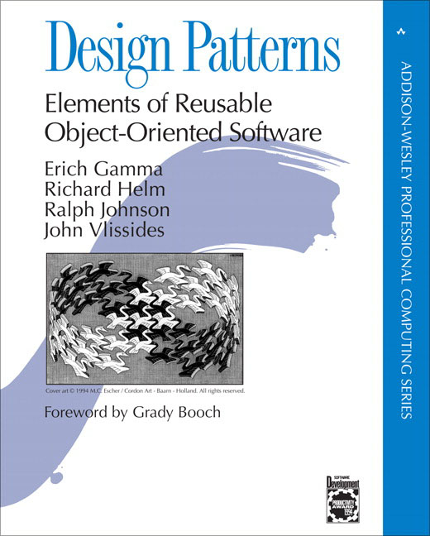
Outline of the Design Space for GoF Patterns
Abstract the process of instantiating objects
Describe how classes & objects can be combined to form larger structures
Concerned with communication between objects
Purpose: Reflects What the Pattern Does
 | Creational | Structural | Behavioral
Class | Factory Method | Adapter (class) | Interpreter Template Method
Object | Abstract Factory Builder Prototype Singleton | Adapter (object) Bridge Composite Decorator Flyweight Façade Proxy | Chain of Responsibility Command Iterator Mediator Memento Observer State Strategy Visitor
√
√
√
√
√
√
Scope: Domain Where Pattern Applies
√
√
√
√
√
√
√
√
√
en.wikipedia.org/wiki/Design_Patterns has info on “Gang of Four” (GoF) book

Slide 53
Design Problems & Pattern-Oriented Solutions
Design Problem | Pattern(s)
Extensible expression tree structure | Composite
Encapsulating variability & simplifying memory management | Bridge
Parsing expressions & creating expression tree | Interpreter & Builder
Extensible tree operations | Iterator & Visitor
Implementing STL iterator semantics | Prototype
Consolidating user operations | Command
Consolidating creation of variabilities for commands, iterators, etc. | Abstract Factory & Factory Method
Binary
Nodes
Unary
Node
Leaf
Nodes

Slide 54
Design Problems & Pattern-Oriented Solutions
Design Problem | Pattern(s)
Extensible expression tree structure | Composite
Encapsulating variability & simplifying memory management | Bridge
Parsing expressions & creating expression tree | Interpreter & Builder
Extensible tree operations | Iterator & Visitor
Implementing STL iterator semantics | Prototype
Consolidating user operations | Command
Consolidating creation of variabilities for commands, iterators, etc. | Abstract Factory & Factory Method
Binary
Nodes
Unary
Node
Leaf
Nodes

Slide 55
Design Problems & Pattern-Oriented Solutions
Design Problem | Pattern(s)
Extensible expression tree structure | Composite
Encapsulating variability & simplifying memory management | Bridge
Parsing expressions & creating expression tree | Interpreter & Builder
Extensible tree operations | Iterator & Visitor
Implementing STL iterator semantics | Prototype
Consolidating user operations | Command
Consolidating creation of variabilities for commands, iterators, etc. | Abstract Factory & Factory Method
Binary
Nodes
Unary
Node
Leaf
Nodes

Slide 56
Design Problems & Pattern-Oriented Solutions
Design Problem | Pattern(s)
Extensible expression tree structure | Composite
Encapsulating variability & simplifying memory management | Bridge
Parsing expressions & creating expression tree | Interpreter & Builder
Extensible tree operations | Iterator & Visitor
Implementing STL iterator semantics | Prototype
Consolidating user operations | Command
Consolidating creation of variabilities for commands, iterators, etc. | Abstract Factory & Factory Method
Binary
Nodes
Unary
Node
Leaf
Nodes

Slide 57
Design Problems & Pattern-Oriented Solutions
Design Problem | Pattern(s)
Extensible expression tree structure | Composite
Encapsulating variability & simplifying memory management | Bridge
Parsing expressions & creating expression tree | Interpreter & Builder
Extensible tree operations | Iterator & Visitor
Implementing STL iterator semantics | Prototype
Consolidating user operations | Command
Consolidating creation of variabilities for commands, iterators, etc. | Abstract Factory & Factory Method
Binary
Nodes
Unary
Node
Leaf
Nodes

Slide 58
Design Problems & Pattern-Oriented Solutions
Design Problem | Pattern(s)
Extensible expression tree structure | Composite
Encapsulating variability & simplifying memory management | Bridge
Parsing expressions & creating expression tree | Interpreter & Builder
Extensible tree operations | Iterator & Visitor
Implementing STL iterator semantics | Prototype
Consolidating user operations | Command
Consolidating creation of variabilities for commands, iterators, etc. | Abstract Factory & Factory Method
Binary
Nodes
Unary
Node
Leaf
Nodes

Slide 59
Design Problems & Pattern-Oriented Solutions
Design Problem | Pattern(s)
Extensible expression tree structure | Composite
Encapsulating variability & simplifying memory management | Bridge
Parsing expressions & creating expression tree | Interpreter & Builder
Extensible tree operations | Iterator & Visitor
Implementing STL iterator semantics | Prototype
Consolidating user operations | Command
Consolidating creation of variabilities for commands, iterators, etc. | Abstract Factory & Factory Method
Binary
Nodes
Unary
Node
Leaf
Nodes

Slide 60
Design Problems & Pattern-Oriented Solutions
Design Problem | Pattern(s)
Ensuring correct protocol for processing commands | State
Structuring the application event flow | Reactor
Supporting multiple operation modes | Template Method & Strategy
Centralizing access to global resources | Singleton
Eliminating loops via the STL std::for_each() algorithm | Adapter
Binary
Nodes
Unary
Node
Leaf
Nodes

Slide 61

Design Problems & Pattern-Oriented Solutions
Design Problem | Pattern(s)
Ensuring correct protocol for processing commands | State
Structuring the application event flow | Reactor
Supporting multiple operation modes | Template Method & Strategy
Centralizing access to global resources | Singleton
Eliminating loops via the STL std::for_each() algorithm | Adapter
Binary
Nodes
Unary
Node
Leaf
Nodes
See www.dre.vanderbilt.edu/~schmidt/PDF/Reactor.pdf for the Reactor pattern

Slide 62
Design Problems & Pattern-Oriented Solutions
Design Problem | Pattern(s)
Ensuring correct protocol for processing commands | State
Structuring the application event flow | Reactor
Supporting multiple operation modes | Template Method & Strategy
Centralizing access to global resources | Singleton
Eliminating loops via the STL std::for_each() algorithm | Adapter
Binary
Nodes
Unary
Node
Leaf
Nodes

Slide 63
Design Problems & Pattern-Oriented Solutions
Design Problem | Pattern(s)
Ensuring correct protocol for processing commands | State
Structuring the application event flow | Reactor
Supporting multiple operation modes | Template Method & Strategy
Centralizing access to global resources | Singleton
Eliminating loops via the STL std::for_each() algorithm | Adapter
Binary
Nodes
Unary
Node
Leaf
Nodes

Slide 64
Design Problems & Pattern-Oriented Solutions
Design Problem | Pattern(s)
Ensuring correct protocol for processing commands | State
Structuring the application event flow | Reactor
Supporting multiple operation modes | Template Method & Strategy
Centralizing access to global resources | Singleton
Eliminating loops via the STL std::for_each() algorithm | Adapter
Binary
Nodes
Unary
Node
Leaf
Nodes
Naturally, these patterns apply to more than expression tree processing apps!

Slide 65
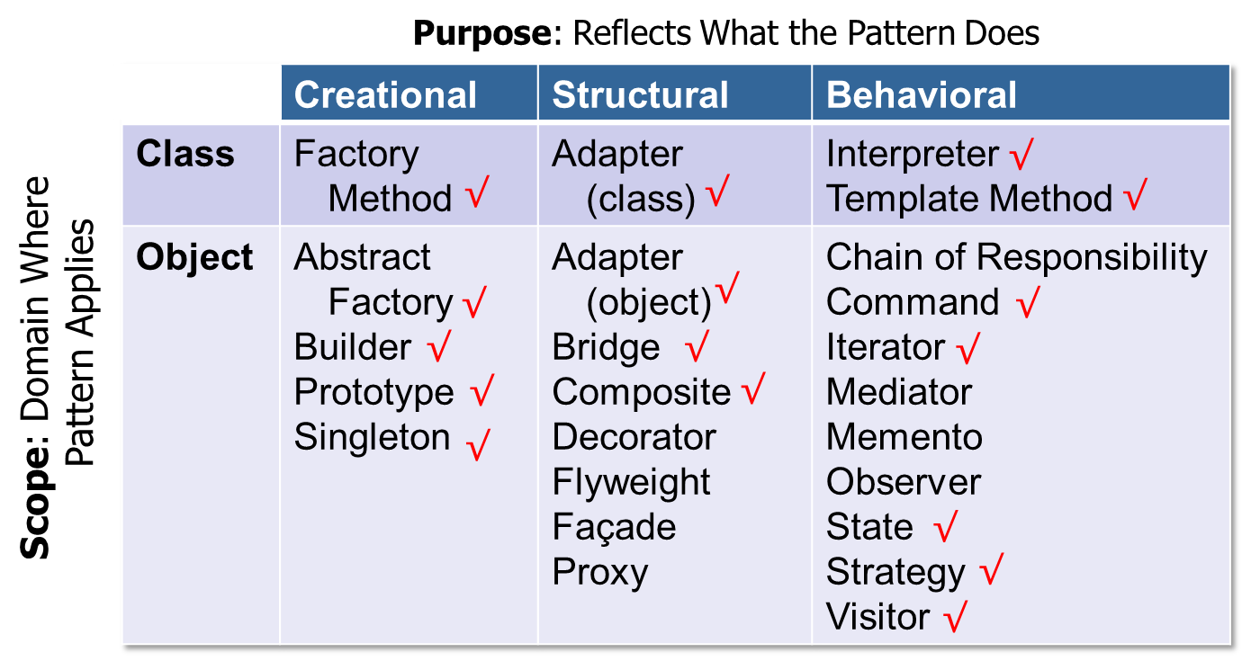
Summary
GoF patterns provide elements of reusable object-oriented software that address limitations with algorithmic decomposition

Slide 66
A Case Study of “Gang of Four” (GoF) Patterns : Part 5
Douglas C. Schmidt
d.schmidt@vanderbilt.edu
www.dre.vanderbilt.edu/~schmidt
Professor of Computer Science
Institute for Software Integrated Systems Vanderbilt University Nashville, Tennessee, USA

Slide 67
Topics Covered in this Part of the Module
Describe the object-oriented (OO) expression tree case study
Evaluate the limitations with algorithmic design techniques
Present an OO design for the expression tree processing app
Summarize the patterns in the expression tree design
Explore patterns for
Tree structure & access
Expression_Tree
Component_Node
Composite_
Unary_Node
Leaf_Node
Composite_Binary _Node
Composite_Negate _Node
Composite_
Add_Node
Composite_
Subtract_Node
Composite_
Multiply_Node
Composite_
Divide_Node

Slide 68
Overview of Tree Structure & Access Patterns
Purpose: Define the key internal data structure for the expression tree & simplify access to this data structure
Expression_Tree
Component_Node
Composite_
Unary_Node
Leaf_Node
Composite_Binary _Node
Composite_Negate _Node
Composite_
Add_Node
Composite_
Multiply_Node
Composite_
Subtract_Node
Composite_
Divide_Node
Bridge
Composite

Slide 69
Problem: Extensible Expression Tree Structure
Goals
Support “physical” structure of expression tree
e.g., binary/unary operators & operands

Slide 70
Problem: Extensible Expression Tree Structure
Goals
Support “physical” structure of expression tree
e.g., binary/unary operators & operands
Provide “hook methods” that enable arbitrary operations on tree nodes
Operation 1: Print all the values of the nodes in the tree
Operation 2: Evaluate the “yield” of the nodes in the tree

Slide 71
Problem: Extensible Expression Tree Structure
Goals
Support “physical” structure of expression tree
e.g., binary/unary operators & operands
Provide “hook methods” that enable arbitrary operations on tree nodes
Constraints/forces
Treat operators & operands uniformly
No distinction between one vs. many to avoid special cases
Eliminate need for type tags & switch statements, cf. algorithmic decomposition

Slide 72
Solution: Recursive Structure
Model an expression tree as a recursive collection of nodes

Slide 73
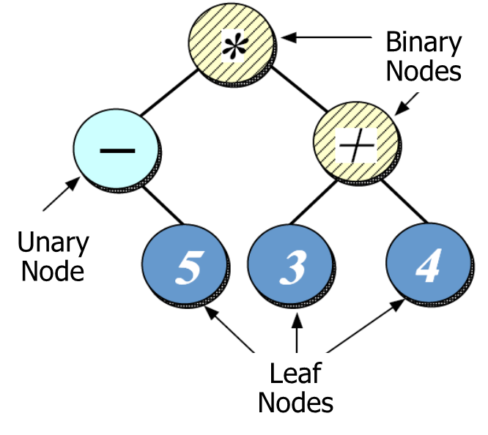
Solution: Recursive Structure
Model an expression tree as a recursive collection of nodes
Nodes are represented in a hierarchy that captures properties of each node, e.g.:
Leaf nodes contain no children

Slide 74
Solution: Recursive Structure
Model an expression tree as a recursive collection of nodes
Nodes are represented in a hierarchy that captures properties of each node, e.g.:
Leaf nodes contain no children
Unary nodes recursively contain one other child node

Slide 75
Solution: Recursive Structure
Model an expression tree as a recursive collection of nodes
Nodes are represented in a hierarchy that captures properties of each node, e.g.:
Leaf nodes contain no children
Unary nodes recursively contain one other child node
Binary nodes recursively contain two other child nodes

Slide 76
Component_Node Class Interface
Abstract base class for composable expression tree node objects
Virtual destructor ensures nodes are all deleted properly
Interface
virtual | ~Component_Node()=0
virtual int | item() const
virtual Component_Node * | left() const
virtual Component_Node * | right() const
virtual void | accept(ET_Visitor &visitor) const
This hook method plays an essential role in Iterator & Visitor patterns (covered later)
Subclasses
Leaf_Node, Composite_Unary_Node, Composite_Binary_Node, etc.
Commonality: Base class interface used by all nodes in an expression tree
Variability: Each subclass defines state & method implementations that are specific for the various types of nodes

Slide 77
Component_Node Class Hierarchy
Component_Node
e.g., Leaf_Node is a Component_Node
Note the inherent recursion in this hierarchy
Composite_
Unary_Node
Leaf_Node
e.g., Composite_Unary_Node is a Component_Node & also has a Component_Node
Composite_Binary _Node
Composite_Negate _Node
Composite_
Add_Node
Composite_
Subtract_Node
e.g., Composite_Binary_Node is a Composite_Unary_Node & also has a Component_Node
Composite_
Multiply_Node
Composite_
Divide_Node
Eliminates need for type tags & switch statements by treating nodes uniformly!

Slide 78
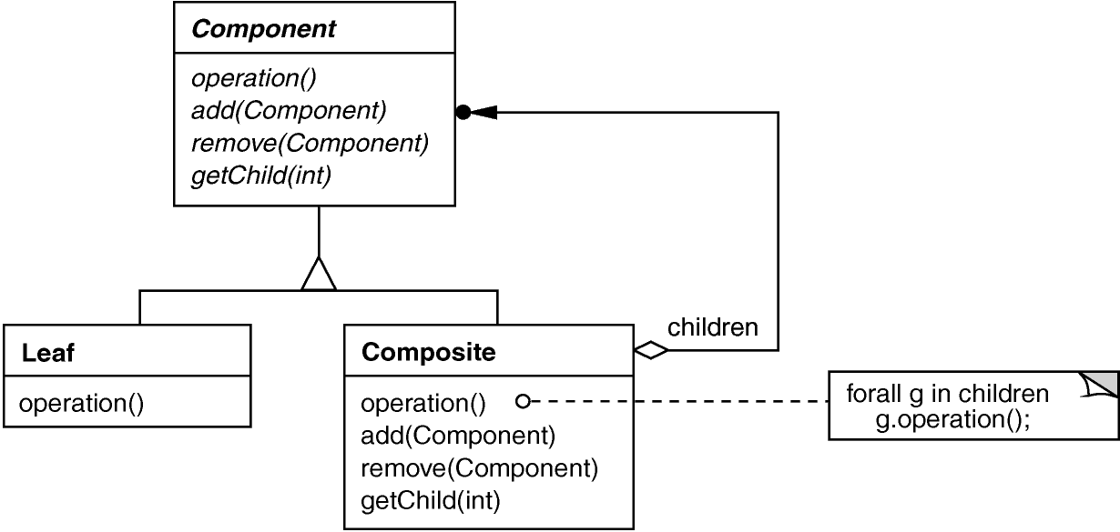
Composite GoF Object structural
Intent
Treat individual objects & multiple, recursively-composed objects uniformly
Applicability
Objects must be composed recursively
and no distinction between individual & composed elements
and objects in structure can be treated uniformly
Structure
e.g., Component_Node
e.g., Composite_Unary_Node, Composite_Binary_Node, Composite_Add_Node, etc.
e.g., Leaf_Node

Slide 79
Composite GoF Object structural
Composite example in C++
Build an expression tree based on recursively-composed objects
Component_Node *l1 = new Leaf_Node(5);
Component_Node *l2 = new Leaf_Node(3);
Component_Node *l3 = new Leaf_Node(4);
l1
l2
l3

Slide 80
Composite GoF Object structural
Composite example in C++
Build an expression tree based on recursively-composed objects
Component_Node *l1 = new Leaf_Node(5);
Component_Node *l2 = new Leaf_Node(3);
Component_Node *l3 = new Leaf_Node(4);
Component_Node *u1 = new Composite_Negate_Node(l1);
Component_Node *b1 = new Composite_Add_Node(l2, l3);
u1
b1
l1
l2
l3

Slide 81
Composite GoF Object structural
Composite example in C++
Build an expression tree based on recursively-composed objects
Component_Node *l1 = new Leaf_Node(5);
Component_Node *l2 = new Leaf_Node(3);
Component_Node *l3 = new Leaf_Node(4);
Component_Node *u1 = new Composite_Negate_Node(l1);
Component_Node *b1 = new Composite_Add_Node(l2, l3);
Component_Node *b2 = new Composite_Multiply_Node(u1, b1);
b2
u1
b1
l1
l2
l3
In C++ we need to consider how to manage dynamically allocated memory

Slide 82
Composite GoF Object structural
Composite example in Java
Build an expression tree based on recursively-composed objects
ComponentNode l1 = new LeafNode(5);
ComponentNode l2 = new LeafNode(3);
ComponentNode l3 = new LeafNode(4);
ComponentNode u1 = new CompositeNegateNode(l1);
ComponentNode b1 = new CompositeAddNode(l2, l3);
ComponentNode b2 = new CompositeMultiplyNode(u1, b1);
b2
u1
b1
l1
l2
l3
Java’s garbage collection handles dynamically allocated memory automatically

Slide 83
Composite GoF Object structural
Consequences
Uniformity: Treat components the same regardless of complexity & behavior
Extensibility: New component subclasses work wherever existing ones do
Parsimony: Classes only include fields they need
Perceived complexity: May need what seems like a prohibitive numbers of classes/objects
Awkward designs: May need to treat leaves as lobotomized composites in some cases

Slide 84
Composite GoF Object structural
Consequences
Uniformity: Treat components the same regardless of complexity & behavior
Extensibility: New Component subclasses work wherever existing ones do
Parsimony: Classes only include fields they need
Perceived complexity: May need what seems like a prohibitive numbers of classes/objects
Awkward designs: May need to treat leaves as lobotomized composites in some cases
Implementation
Do components know their parents?
Uniform interface for both leaves & composites?
Don’t allocate storage for children in component base class (big problem with algorithmic decomposition solution)
Who is responsible for deleting children?

Slide 85
Composite GoF Object structural
Consequences
Uniformity: Treat components the same regardless of complexity & behavior
Extensibility: New Component subclasses work wherever existing ones do
Parsimony: Classes only include fields they need
Perceived complexity: May need what seems like a prohibitive numbers of classes/objects
Awkward designs: May need to treat leaves as lobotomized composites in some cases
Implementation
Do components know their parents?
Uniform interface for both leaves & composites?
Don’t allocate storage for children in component base class (big problem with algorithmic decomposition solution)
Who is responsible for deleting children?
Known Uses
ET++ Vobjects
InterViews Glyphs, Styles
Unidraw Components, MacroCommands
Directory structures on UNIX & Windows
Naming Contexts in CORBA
Internal representations of MIME types

Slide 86
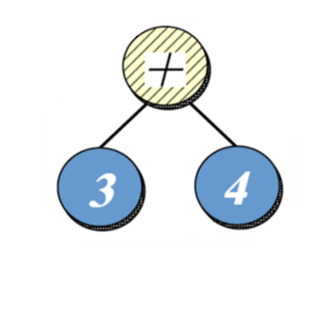
Problem: Encapsulating Variability & Simplifying Memory Management
Goals
Help encapsulate sources of variability in expression tree construction & use
Expression_Tree expr_tree (new Composite_Add_Node (new Leaf_Node (3), new Leaf_Node (4)));
Hide complex recursive internal structure behind a simple interface

Slide 87
Problem: Encapsulating Variability & Simplifying Memory Management
Goals
Help encapsulate sources of variability in expression tree construction & use
Expression_Tree expr_tree (new Composite_Add_Node (new Leaf_Node (3), new Leaf_Node (4)));
Print_Visitor print_visitor;
for (auto iter = expr_tree.begin();
iter != expr_tree.end();
++iter)
(*iter).accept(print_visitor);
Iterate through all elements in expression tree without concern for how tree is structured or what traversal has been designated

Slide 88
Problem: Encapsulating Variability & Simplifying Memory Management
Goals
Help encapsulate sources of variability in expression tree construction & use
Expression_Tree expr_tree (new Composite_Add_Node (new Leaf_Node (3), new Leaf_Node (4)));
Print_Visitor print_visitor;
for (auto iter = expr_tree.begin();
iter != expr_tree.end();
++iter)
(*iter).accept(print_visitor);
Note how C++11 auto keyword can deduce type of Expression _Tree iterator

Slide 89
Problem: Encapsulating Variability & Simplifying Memory Management
Goals
Help encapsulate sources of variability in expression tree construction & use
Simplify memory management
e.g., minimize use of “naked pointers” in C++ app code to avoid memory leaks stemming from exceptions
Component_Node *l1 = new Leaf_Node(5);
Component_Node *l2 = new Leaf_Node(3);
Component_Node *l3 = new Leaf_Node(4);
Component_Node *u1 = new Composite_Negate_Node(l1);
Component_Node *b1 = new Composite_Add_Node(l2, l3);
Component_Node *b2 = new Composite_Multiply_Node(u1, b1);
...
delete b2;
This is just asking for trouble in C++!

Slide 90
Problem: Encapsulating Variability & Simplifying Memory Management
Goals
Help encapsulate sources of variability in expression tree construction & use
Simplify memory management
e.g., minimize use of “naked pointers” in C++ app code to avoid memory leaks stemming from exceptions
Constraints/forces
Account for the fact that STL algorithms & iterators have “value semantics”
class Pre_Order_ET_Iterator_Impl : public ET_Iterator_Impl {
public:
Pre_Order_ET_Iterator_Impl (const Expression_Tree &root) {
stack_.push(root);
}
// ...
private:
std::stack<Expression_Tree> stack_;
};
Need to optimize this operation to avoid overhead of “deep copies”

Slide 91
Solution: Decouple Interface & Implementation(s)
Create an interface class (Expression_Tree) used by clients
Expression _Tree

Slide 92
Solution: Decouple Interface & Implementation(s)
Create an interface class (Expression_Tree) used by clients & an implementor hierarchy (Component_Node et al) that encapsulates variability
Expression _Tree
Component _Node
Interface class can use a C++ std::shared_ptr reference count object to help automate memory management
Composite_
Unary_Node
Leaf_Node
Composite_ Binary_Node
Composite_ Negate_Node
Composite_
Add_Node
Composite_
Subtract_Node
Composite_
Multiply_Node
Composite_
Divide_Node

Slide 93
Solution: Decouple Interface & Implementation(s)
Create an interface class (Expression_Tree) used by clients & an implementor hierarchy (Component_Node et al) that encapsulates variability
Expression _Tree
Component _Node
Composite_
Unary_Node
Leaf_Node
Composite_ Binary_Node
Composite_ Negate_Node
The Abstract Factory pattern can be used to produce the right implementor hierarchy (as seen later)
Composite_
Add_Node
Composite_
Subtract_Node
Composite_
Multiply_Node
Composite_
Divide_Node

Slide 94
Expression_Tree Class Interface
Interface for composite structure that contains all nodes in expression tree
Interface
 | typedef ET_Iterator iterator
 | ...
 | Expression_Tree(Component_Node *root)
 | Expression_Tree(const Expression_Tree &t)
void | operator=(const Expression_Tree &t)
 | ~Expression_Tree()
bool | is_null() const
const int | item() const
Expression_Tree | left()
Expression_Tree | right()
void | accept(ET_Visitor &visitor)
iterator | begin(const std::string &order = "")
iterator | end(const std::string &order = "")
const_iterator | begin(const std::string order = "") const
const_iterator | end(const std::string &order = "") const
Manage reference counts
Plays essential role in Iterator & Visitor patterns (covered later)
Forward to implementor hierarchy

Slide 95
Expression_Tree Class Interface
Interface for composite structure that contains all nodes in expression tree
Interface
 | typedef ET_Iterator iterator
 | ...
 | Expression_Tree(Component_Node *root)
 | Expression_Tree(const Expression_Tree &t)
void | operator=(const Expression_Tree &t)
 | ~Expression_Tree()
bool | is_null() const
const int | item() const
Expression_Tree | left()
Expression_Tree | right()
void | accept(ET_Visitor &visitor)
iterator | begin(const std::string &order = "")
iterator | end(const std::string &order = "")
const_iterator | begin(const std::string order = "") const
const_iterator | end(const std::string &order = "") const
Iterator trait
Iterator factories
Commonality: Provides common interface for expression tree operations
Variability: The contents of the composite nodes in the expression tree will vary depending on the user input expression

Slide 96
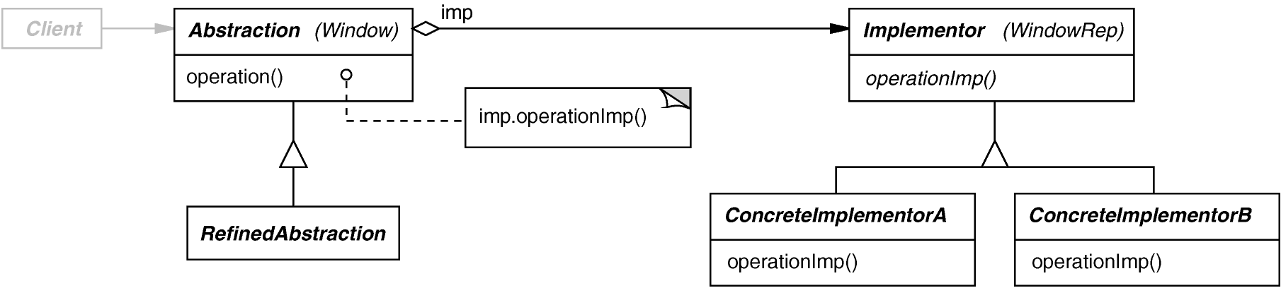
Bridge GoF Object Structural
Intent
Separate an interface from its implementation(s)
Applicability
When interface & implementation should vary independently
Require a uniform interface to interchangeable implementor hierarchies
Structure
e.g., Expression_Tree
e.g., Component_Node
e.g., Composite_Unary_Node, Composite_Binary_Node, etc.

Slide 97
Bridge GoF Object Structural
Bridge example in C++
Separate expression tree interface from the composite node implementations
class Expression_Tree { public: Expression_Tree(Component_Node *root): root_(root) {}
... void accept(ET_Visitor &v) { root_->accept(v); } private: std::shared_ptr <Component_Node> root_;
root_ manages lifecycle of pointer parameter
Interface forwards to implementor via shared_ptr
C++11/Boost “smart pointer” that handles reference counting
See en.wikipedia.org/wiki/Smart_pointer#shared_ptr_and_weak_ptr for more

Slide 98
Bridge GoF Object Structural
Bridge example in C++
Separate expression tree interface from the composite node implementations
class Expression_Tree { public: Expression_Tree(Component_Node *root): root_(root) {}
... void accept(ET_Visitor &v) { root_->accept(v); } private: std::shared_ptr <Component_Node> root_;
...
Expression_Tree expr_tree (new Composite_Multiply_Node(u1, b1));
expr_tree manages lifecycle of composite via Bridge pattern

Slide 99
Bridge GoF Object Structural
Consequences
Abstraction interface & implementor hierarchy are decoupled
Implementors can vary dynamically
Enables efficient use of value-based STL algorithms & containers
One-size-fits-all abstraction & implementor interfaces

Slide 100
Bridge GoF Object Structural
Consequences
Abstraction interface & implementor hierarchy are decoupled
Implementors can vary dynamically
Enables efficient use of value-based STL algorithms & containers
One-size-fits-all abstraction & implementor interfaces
Implementation
Sharing implementors & reference counting
e.g., C++11/Boost shared_ptr
Creating the right implementor
Often addressed by using factories
Not as widely used in Java as in C++

Slide 101
Bridge GoF Object Structural
Consequences
Abstraction interface & implementor hierarchy are decoupled
Implementors can vary dynamically
Enables efficient use of value-based STL algorithms & containers
One-size-fits-all abstraction & implementor interfaces
Implementation
Sharing implementors & reference counting
e.g., C++11/Boost shared_ptr
Creating the right implementor
Often addressed by using factories
Not as widely used in Java as in C++
Known Uses
ET++ Window/WindowPort
libg++ Set/{LinkedList, HashTable}
AWT Component/ ComponentPeer
Java Socket/SocketImpl
ACE Reactor framework

Slide 102
Summary of Tree Structure & Access Patterns
Composite is used to define internal data structure for the expression tree processing app & Bridge simplifies access to this data structure for C++ code
Expression_Tree
Component_Node
Composite_
Unary_Node
Leaf_Node
Composite_Binary _Node
Composite_Negate _Node
Composite_
Add_Node
Composite_
Multiply_Node
Composite_
Subtract_Node
Composite_
Divide_Node
Bridge
Composite
Bridge Composite is an example of a “pattern compound”

Slide 103
A Case Study of “Gang of Four” (GoF) Patterns : Part 6
Douglas C. Schmidt
d.schmidt@vanderbilt.edu
www.dre.vanderbilt.edu/~schmidt
Professor of Computer Science
Institute for Software Integrated Systems Vanderbilt University Nashville, Tennessee, USA

Slide 104
Topics Covered in this Part of the Module
Describe the object-oriented (OO) expression tree case study
Evaluate the limitations with algorithmic design techniques
Present an OO design for the expression tree processing app
Summarize the patterns in the expression tree design
Explore patterns for
Tree structure & access
Tree creation
In_Order_ Uninitialized_State
make_tree()
ET_Interpreter _Context
ET_Interpreter
Symbol
Number
Operator
Unary_Operator
Add
Subtract
Negate
Multiply
Divide

Slide 105
Overview of Tree Creation Patterns
Purpose: Parse user input expresion & create the internal data structure for the expression tree
Interpreter
Expression_Tree
ET_Context
ET_Interpreter_Context
<< use >>
ET_Interpreter
Component_Node
Symbol
<< build >>
Leaf_Node
Composite_
Binary_Node
Composite_
Unary_Node
Number
Operator
Unary_Operator
<<build>>
Composite_
Add_Node
Composite_
Subtract_Node
Composite_
Negate_Node
Add
Subtract
Negate
Composite_
Multiply_Node
Composite_
Divide_Node
Multiply
Divide
<<build>>
Composite
Builder
There are many classes, but only a handful of patterns involved in this design

Slide 106
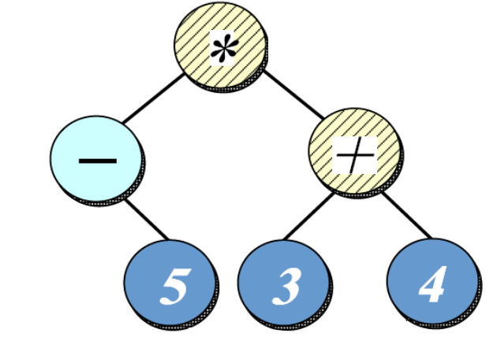
Problem: Parsing Expressions & Creating an Expression Tree
Goals
Simplify & centralize the creation of all nodes in the composite expression tree
“in-order” expression = -5*(3+4)

Slide 107
Problem: Parsing Expressions & Creating an Expression Tree
Goals
Simplify & centralize the creation of all nodes in the composite expression tree
Be extensible for future types of expression formats & optimizations
“pre-order” expression = *-5+34
“post-order” expression = 5-34+*
“level-order” expression = *-+534
“in-order” expression = -5*(3+4)

Slide 108
Problem: Parsing Expressions & Creating an Expression Tree
Goals
Simplify & centralize the creation of all nodes in the composite expression tree
Be extensible for future types of expression formats & optimizations
Constraints/forces
Don’t recode existing clients when new types of expression formats are added
Add new user input expressions without recompiling existing code
“pre-order” expression = *-5+34
“post-order” expression = 5-34+*
“level-order” expression = *-+534
“in-order” expression = -5*(3+4)

Slide 109
Solution: Build Expression Tree Using Interpreter
Use an interpreter to create a parse tree corresponding to user input expression
In_Order_ Uninitialized_State
make_tree()
ET_Interpreter
Symbol
ET_Interpreter _Context
Operator
Unary_Operator
Multiply
Negate
Number
Add

Slide 110
Solution: Build Expression Tree Using Interpreter
Use an interpreter to create a parse tree corresponding to user input expression
This parse tree is then traversed to build the appropriate type of nodes in the corresponding expression tree
We create the entire parse tree to enable optimizations (as a future extension)
In_Order_ Uninitialized_State
make_tree()
ET_Interpreter
Symbol
ET_Interpreter _Context
Operator
Unary_Operator
Multiply
Negate
Number
Add
<<build>>

Slide 111
ET_Interpreter Class Interface
Transforms expressions into a parse tree & then generates the corresponding expression tree
Interface
virtual | ~ET_Interpreter()
Expression_Tree | interpret(ET_Interpreter_Context &context, const std::string &input)
<<uses>>
 | ET_Interpreter_Context()
 | ~ET_Interpreter_Context()
int | get(std::string variable)
void | set(std::string variable, int value)
void | print()
void | reset()
The context can be used to implement setters/getters for variable leaf nodes

Slide 112
ET_Interpreter Class Interface
Transforms expressions into a parse tree & then generates the corresponding expression tree
Interface
virtual | ~ET_Interpreter()
Expression_Tree | interpret(ET_Interpreter_Context &context, const std::string &input)
<<creates>>
Abstract base class of all parse tree nodes
 | Symbol(Symbol *left, Symbol *right)
virtual | ~Symbol()
virtual int | precedence()=0
virtual Component_Node * | build()=0
This method is used to build a component node corresponding to the expression parse tree node

Slide 113
ET_Interpreter Class Interface
Transforms expressions into a parse tree & then generates the corresponding expression tree
Interface
virtual | ~ET_Interpreter()
Expression_Tree | interpret(ET_Interpreter_Context &context, const std::string &input)
<<uses>>
 | ET_Interpreter_Context()
 | ~ET_Interpreter_Context()
int | get(std::string variable)
void | set(std::string variable, int value)
void | print()
void | reset()
<<creates>>
 | Symbol(Symbol *left, Symbol *right)
virtual | ~Symbol()
virtual int | precedence()=0
virtual Component_Node * | build()=0
Commonality: Provides a common interface building parse trees & expression trees from user input expressions
Variability: The structure of the parse trees & expression trees can vary depending on the format & contents of the expression input

Slide 114
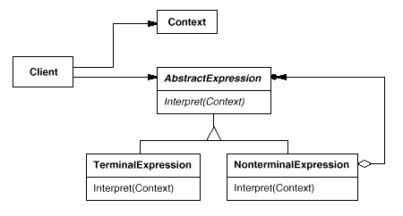
Interpreter GoF Class Behavioral
Intent
Given a language, define a representation for its grammar, along with an interpreter that uses the representation to interpret sentences in the language
Applicability
When the grammar is simple & relatively stable
When time/space efficiency is not a critical concern
Structure
e.g., Symbol
e.g., operators like Add, Subtract, Multiply, Divide, etc.
e.g., Number or Variable

Slide 115
Interpreter GoF Class Behavioral
Interpreter example in C++
The interpret() method creates a parse tree from user’s expression input
Expression_Tree ET_Interpreter::interpret (ET_Interpreter_Context &context, const std::string &input) {
std::list<Symbol *> parse_tree; ...
if(is_number(input[i])){
number_insert(input, parse_tree);
} else if(input[i] == '+'){
Add *op = new Add(); op->add_precedence(accum_precedence);
precedence_insert(op, parse_tree);
...
} else if(input[i] == '(') {
handle_parenthesis(context, input, accum_precedence, parse_tree);
}
...
Symbols added to parse tree as interpreter recognizes them
Handle operand
Handle addition operator
Handle parenthesized expression

Slide 116
Interpreter GoF Class Behavioral
Consequences
Simple grammars are easy to change & extend
e.g., All rules represented by distinct classes in a consistent & orderly manner
Adding another rule adds another class
Complex grammars hard to create & maintain
e.g., More inter-dependent rules yield more inter-dependent classes
Complex grammars may require different approach (e.g., parser generators)

Slide 117
Interpreter GoF Class Behavioral
Consequences
Simple grammars are easy to change & extend
e.g., All rules represented by distinct classes in a consistent & orderly manner
Adding another rule adds another class
Complex grammars hard to create & maintain
e.g., More inter-dependent rules yield more inter-dependent classes
Implementation
Express language rules, one per class
Literal translations expressed as terminal expressions
Alternations, repetitions, or sequences expressed as nonterminal expresssions

Slide 118
Interpreter GoF Class Behavioral
Consequences
Simple grammars are easy to change & extend
e.g., All rules represented by distinct classes in a consistent & orderly manner
Adding another rule adds another class
Complex grammars hard to create & maintain
e.g., More inter-dependent rules yield more inter-dependent classes
Implementation
Express language rules, one per class
Literal translations expressed as terminal expressions
Alternations, repetitions, or sequences expressed as nonterminal expresssions
Known Uses
Text editors & web browsers use Interpreter to lay out documents & check spelling
e.g., an equation in TeX is represented as a tree where internal nodes are operators & leaves are variables
Smalltalk compilers
The QOCA constraint-solving toolkit

Slide 119
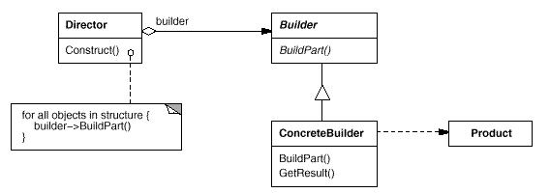
Builder GoF Object Creational
Intent
Separate the construction of a complex object from its representation so that the same construction process can create different representations
Applicability
Need to isolate knowledge of the creation of a complex object from its parts
Need to allow different implementations/interfaces of an object's parts
Structure
e.g., Symbol
e.g., Leaf_Node, Composite_Add _Node, etc.
e.g., ET_Interpreter
e.g., Number, Subtract, Add, Multiply, etc.

Slide 120
Builder GoF Object Creational
Builder example in C++
The interpret() method builds composite expression tree from parse tree
Expression_Tree ET_Interpreter::interpret (ET_Interpreter_Context &context, const std::string &input) {
...
return Expression_Tree(parse_tree.back()->build());
Invoke a recursive expression tree build, starting with the root symbol in parse tree created by the interpreter

Slide 121
Builder GoF Object Creational
Builder example in C++
The interpret() method builds composite expression tree from parse tree
Expression_Tree ET_Interpreter::interpret (ET_Interpreter_Context &context, const std::string &input) {
...
return Expression_Tree(parse_tree.back()->build());
Component_Node *
Multiply::build() {
return new Composite_Multiply_Node (left_->build(), right_->build());
}
Component_Node *Number::build() {
return new Leaf_Node(item_);
}
Build equivalent component nodes

Slide 122
Builder GoF Object Creational
Consequences
Can vary a product's internal representation
Isolates code for construction & representation
Finer control over the construction process
May involve a lot of classes

Slide 123
Builder GoF Object Creational
Consequences
Can vary a product's internal representation
Isolates code for construction & representation
Finer control over the construction process
May involve a lot of classes
Implementation
The Builder pattern is a “factory pattern with a mission”
A Builder pattern implementation exposes itself as a factory
It goes beyond conventional factory patterns by connecting various implementations together

Slide 124
Builder GoF Object Creational
Consequences
Can vary a product's internal representation
Isolates code for construction & representation
Finer control over the construction process
May involve a lot of classes
Implementation
The Builder pattern is a “factory pattern with a mission”
A Builder pattern implementation exposes itself as a factory
It goes beyond conventional factory patterns by connecting various implementations together
Known Uses
ET++ RTF converter application
Smalltalk-80
ACE Service Configurator framework

Slide 125
Summary of Tree Creation Patterns
Interpreter & Builder patterns create internal data structure for expression tree from user input
Interpreter
Expression_Tree
ET_Context
ET_Interpreter_Context
<< use >>
ET_Interpreter
Component_Node
Symbol
<< build >>
Leaf_Node
Composite_
Binary_Node
Composite_
Unary_Node
Number
Operator
Unary_Operator
<<build>>
Composite_
Add_Node
Composite_
Subtract_Node
Composite_
Negate_Node
Add
Subtract
Negate
Composite_
Multiply_Node
Composite_
Divide_Node
Multiply
Divide
<<build>>
Composite
Builder
Interpreter, Builder, & Composite are powerful “pattern sequence”

Slide 126
A Case Study of “Gang of Four” (GoF) Patterns : Part 7
Douglas C. Schmidt
d.schmidt@vanderbilt.edu
www.dre.vanderbilt.edu/~schmidt
Professor of Computer Science
Institute for Software Integrated Systems Vanderbilt University Nashville, Tennessee, USA

Slide 127
Topics Covered in this Part of the Module
Describe the object-oriented (OO) expression tree case study
Evaluate the limitations with algorithmic design techniques
Present an OO design for the expression tree processing app
Summarize the patterns in the expression tree design
Explore patterns for
Tree structure & access
Tree creation
Tree traversal
for (auto iter = expr_tree.begin();
iter != expr_tree.end();
++iter)
(*iter).accept(print_visitor);

Slide 128
Overview of Tree Traversal Patterns
Purpose: Traverse the expression tree & perform designated operations
Visitor
<< accept >>
ET_Visitor
Expression_Tree
Component_Node
Iterator
<< create >>
ET_Iterator
ET_Iterator_Impl
Evaluation_Visitor
Print_Visitor
std::queue
Level_Order_ET _Iterator_Impl
Prototype
In_Order_ET_ Iterator_Impl
std::stack
Post_Order_ ET_Iterator_Impl
Pre_Order_ET _Iterator_Impl
Patterns decouple expression tree structure from operations performed on it

Slide 129
Problem: Extensible Expression Tree Operations
Goals
Create a framework for performing operations that affect nodes in a tree
Operation 2: Evaluate the “yield” of the nodes in the tree
Operation 1: Print all the values of the nodes in the tree
Binary
Nodes
Unary
Node
Leaf
Nodes

Slide 130
Problem: Extensible Expression Tree Operations
Goals
Create a framework for performing operations that affect nodes in a tree
Constraints/forces
Support multiple operations on the expression tree without tightly coupling operations with the tree structure
i.e., don’t have print() & evaluate() methods in the node classes
Operation 2: Evaluate the “yield” of the nodes in the tree
Operation 1: Print all the values of the nodes in the tree
Binary
Nodes
Unary
Node
Leaf
Nodes

Slide 131
Solution (Part A): Encapsulate Traversal
Iterator
Encapsulates a traversal algorithm without exposing representation details to callers
e.g.,
“in-order iterator” = -5*(3+4)
“pre-order iterator” = *-5+34
“post-order iterator” = 5-34+*
“level-order iterator” = *-+534
Unary
Node
Leaf
Nodes
for (auto iter = expr_tree.begin();
iter != expr_tree.end();
++iter)
(*iter).accept(print_visitor);

Slide 132
Solution (Part A): Encapsulate Traversal
Iterator
Encapsulates a traversal algorithm without exposing representation details to callers
e.g.,
“in-order iterator” = -5*(3+4)
“pre-order iterator” = *-5+34
“post-order iterator” = 5-34+*
“level-order iterator” = *-+534
Iterator Structure
Unary
Node
Leaf
Nodes
ET_Iterator
ET_Iterator_Impl
In_Order_ET_Iterator_Impl
Post_Order_ET_Iterator_Impl
Level_Order_ET_Iterator_Impl
Pre_Order_ET_Iterator_Impl
Bridge pattern encapsulates variability & simplifies memory management

Slide 133
ET_Iterator Class Interface
Interface for iterator that traverses all nodes in an expression tree instance
This interface plays the role of the abstraction in the Bridge pattern
Interface
 | ET_Iterator(ET_Iterator_Impl *)
 | ET_Iterator(const ET_Iterator &)
Expression_Tree | operator *()
const Expression_Tree | operator *() const
ET_Iterator & | operator++()
ET_Iterator | operator++(int)
bool | operator==(const ET_Iterator &rhs)
bool | operator!=(const ET_Iterator &rhs) ...
Overloaded C++ operators conform to what’s expected from an STL iterator
Commonality: Provides a common interface for expression tree iterators that conforms to the standard STL iterator interface
Variability: Can be configured with specific expression tree iterator algorithms via the Abstract Factory pattern

Slide 134
ET_Iterator_Impl Class Interface
Base class of the iterator implementor hierarchy that defines the various iterations algorithms that can be performed to traverse the expression tree
 | ET_Iterator_Impl (const Expression_Tree &)
virtual | ~ET_Iterator_Impl()
virtual Expression_Tree | operator *()=0
virtual void | operator++()=0
virtual bool | operator== (const ET_Iterator_Impl &)=0
virtual bool | operator!= (const ET_Iterator_Impl &)=0
virtual ET_Iterator_Impl * | clone()=0
Interface
This class doesn’t need to mimic the Bridge interface
clone() is used by Prototype pattern
Commonality: Provides a common interface for implementing expression tree iterators that conforms to the standard STL iterator interface
Variability: Can be subclassed to define various algorithms for accessing nodes in the expression trees in a particular traversal order

Slide 135
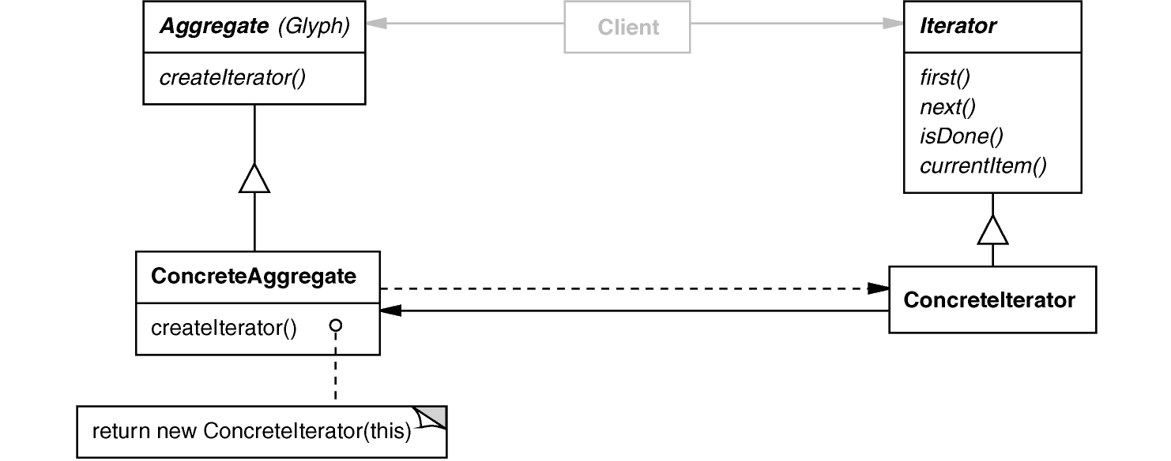
Iterator GoF Object Behavioral
Intent
Access elements of an aggregate without exposing its representation
Applicability
Require multiple traversal algorithms over an aggregate
Require a uniform traversal interface over different aggregates
When aggregate classes & traversal algorithm must vary independently
Structure
e.g., ET_Iterator_Impl
e.g., Expression_Tree
e.g., Pre_Order_ET_Iterator_Impl, In_Order_ET_Iterator_Impl, etc.

Slide 136
Iterator GoF Object Behavioral
Comparing STL iterators with GoF iterators
STL iterators have “value-semantics”, e.g.:
for (auto iter = expr_tree.begin();
iter != expr_tree.end();
++iter)
(*iter).accept(print_visitor);
Easy to use, harder to implement
In contrast, GoF iterators have “pointer semantics”, e.g.:
Easy to implement, harder to use (correctly)
Iterator *iter;
for (iter = exprTree.createIterator();
iter->done() == false;
iter->advance())
iter->currentElement()->accept(printVisitor);
delete iter;
The Bridge pattern enables STL iterator use in expression tree processing app

Slide 137
Iterator GoF Object Behavioral
Comparing Java iterators with GoF iterators
Java iterators are closer to GoF iterators than STL iterators are, e.g.:
for (IteratorL<ExpressionTree> itr = exprTree.iterator();
itr.hasNext(); )
iter.next().accept (printVisitor);
}
Here’s the equivalent Java code for GoF-style iterators, e.g.:
for (ETIterator iter = tree.createIterator();
!iter.done();
iter.advance())
(iter.currentElement()).accept(printVisitor);
Often, the simplest way to use an iterator in C++/Java is to use a for loop

Slide 138
Iterator GoF Object Behavioral
Comparing Java iterators with STL iterators
Often, the simplest way to use an iterator in C++/Java is to use a for loop, e.g.:
C++11 range-based for loop
for (auto &iter : expr_tree)
iter.accept(print_visitor);
for (ComponentNode node : exprTree)
node.accept(printVisitor);
Java for-each loop

Slide 139
Iterator GoF Object Behavioral
Iterator example in C++
An STL std::stack can be used to traverse an expression tree in pre-order
class Pre_Order_ET_Iterator_Impl : public ET_Iterator_Impl { public: Pre_Order_ET_Iterator_Impl(const Expression_Tree &root) { stack_.push (root); }
virtual Expression_Tree operator*() { return stack_.top (); }
virtual void operator++() {
if (!stack_.is_empty()) {
Expression_Tree current = stack_.top(); stack_.pop();
if (!current.right().is_null())
stack_.push(current.right());
if (!current.left().is_null())
stack_.push(current.left());
}
}
...
Begin the iteration
Return current item
Advance one item
The use of a stack simulates recursion, one item at a time

Slide 140
Iterator GoF Object Behavioral
Consequences
Flexibility: Aggregate & traversal are independent
Multiplicity: Multiple iterators & multiple traversal algorithms
Overhead: Additional communication between iterator & aggregate
Particularly problematic for iterators in concurrent or distributed systems

Slide 141
Iterator GoF Object Behavioral
Consequences
Flexibility: Aggregate & traversal are independent
Multiplicity: Multiple iterators & multiple traversal algorithms
Overhead: Additional communication between iterator & aggregate
Particularly problematic for iterators in concurrent or distributed systems
Implementation
Internal vs. external iterators
Violating the object structure’s encapsulation
Robust iterators
Synchronization overhead in multi-threaded programs
Batching in distributed & concurrent programs

Slide 142
Iterator GoF Object Behavioral
Consequences
Flexibility: Aggregate & traversal are independent
Multiplicity: Multiple iterators & multiple traversal algorithms
Overhead: Additional communication between iterator & aggregate
Particularly problematic for iterators in concurrent or distributed systems
Implementation
Internal vs. external iterators
Violating the object structure’s encapsulation
Robust iterators
Synchronization overhead in multi-threaded programs
Batching in distributed & concurrent programs
Known Uses
C++ STL iterators
JDK Enumeration, Iterator
Unidraw Iterator
C++11 range-based for loops & Java for-each loops

Slide 143
Solution (Part B): Decouple Operations from Expression Tree Structure
Visitor
Defines action(s) at each step of traversal & avoids hard-coding action(s) into nodes
Unary
Node
Leaf
Nodes

Slide 144
Solution (Part B): Decouple Operations from Expression Tree Structure
Visitor
Defines action(s) at each step of traversal & avoids hard-coding action(s) into nodes
Iterator calls accept(ET_Visitor&) method on each node in expression tree
Unary
Node
for (auto iter = expr_tree.begin();
iter != expr_tree.end();
++iter)
(*iter).accept(print_visitor);
Leaf
Nodes

Slide 145
Solution (Part B): Decouple Operations from Expression Tree Structure
Visitor
Defines action(s) at each step of traversal & avoids hard-coding action(s) into nodes
Iterator calls accept(ET_Visitor&) method on each node in expression tree
accept() calls back on visitor, e.g.:
Unary
Node
for (auto iter = expr_tree.begin();
iter != expr_tree.end();
++iter)
(*iter).accept(print_visitor);
Leaf
Nodes
void Leaf_Node::accept(ET_Visitor &v) { v.visit(*this); }
Note “static polymorphism” based on method overloading by type

Slide 146
ET_Visitor Class Interface
Interface for a visitor that defines operations performed for each type of node in the expression tree
Interface
An overloaded visit() method is defined for each Component_Node subclass
virtual void | visit(const Leaf_Node &node)=0
virtual void | visit(const Composite_Negate_Node &node)=0
virtual void | visit(const Composite_Add_Node &node)=0
virtual void | visit(const Composite_Subtract_Node &node)=0
virtual void | visit(const Composite_Divide_Node &node)=0
virtual void | visit(const Composite_Multiply_Node &node)=0
Commonality: Provides a common accept()method for all expression tree nodes & common visit()method for all visitor subclasses
Variability: Can be subclassed to define specific behaviors for the visitors & nodes
ET_Visitor
Evaluation_Visitor
Print_Visitor

Slide 147
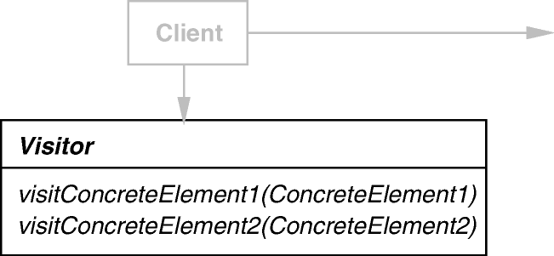
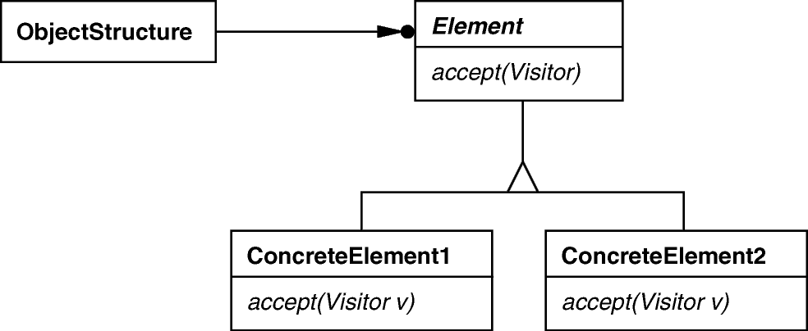
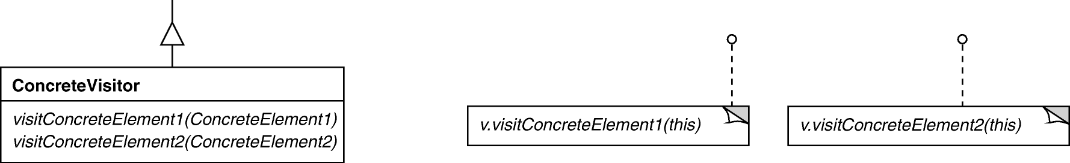
Visitor GoF Object Behavioral
Intent
Centralize operations on an object structure so that they can vary independently, but still behave polymorphically
Applicability
When classes define many unrelated operations
Class relationships in structure rarely change, but operations on them change
Algorithms keep state that’s updated during traversal
e.g., Component_Node
Structure
e.g., ET_Visitor
e.g., Composite_Add_Node, Composite_ Binary_Node, Composite_Unary_Node, etc.
.
e.g., Evaluation_Visitor, Print_Visitor, etc.

Slide 148
Visitor GoF Object Behavioral
Visitor implementation in C++
The Print_Visitor class prints character code or value for each node
class Print_Visitor : public ET_Visitor {
public:
virtual void visit(const Leaf_Node &);
virtual void visit(const Add_Node &);
virtual void visit(const Divide_Node &);
// etc.
};
for all relevant Component_Node subclasses

Slide 149
Visitor GoF Object Behavioral
Visitor implementation in C++
The Print_Visitor class prints character code or value for each node
Can be combined with any traversal algorithm, e.g.:
class Print_Visitor : public ET_Visitor {
public:
virtual void visit(const Leaf_Node &);
virtual void visit(const Add_Node &);
virtual void visit(const Divide_Node &);
// etc.
};
Print_Visitor print_visitor;
for (auto iter = expr_tree.begin("post-order");
iter != exor_tree.end("post-order");
++iter)
(*iter).accept(print_visitor);
calls visit(*this)

Slide 150
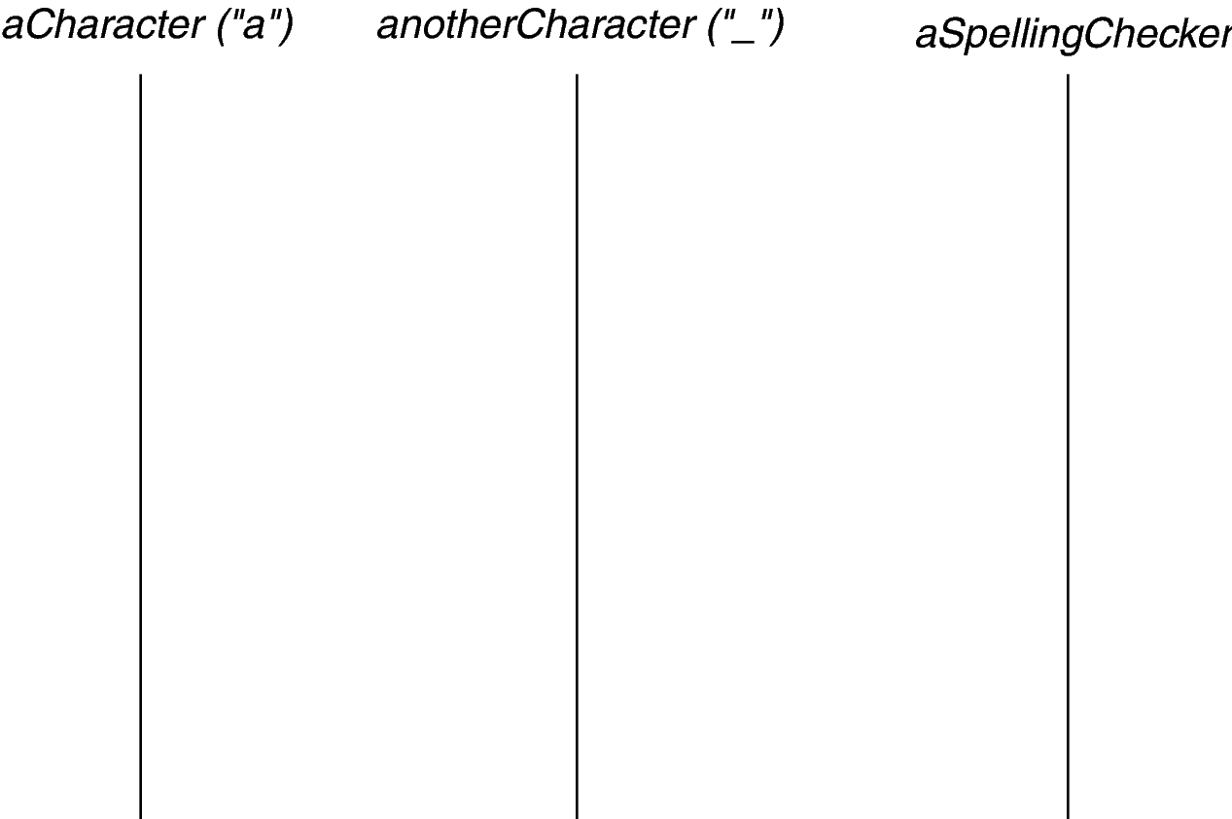
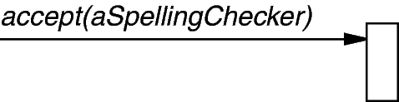
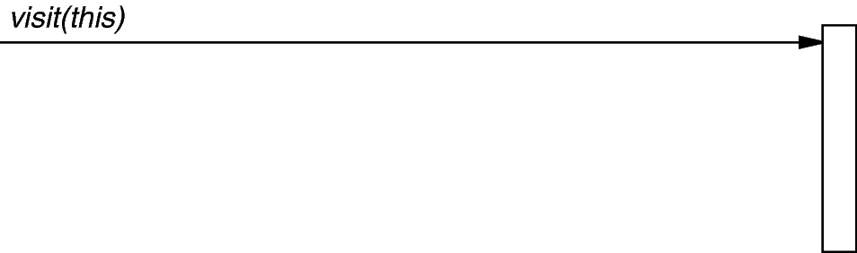
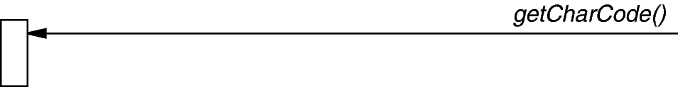
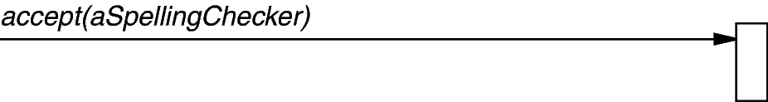
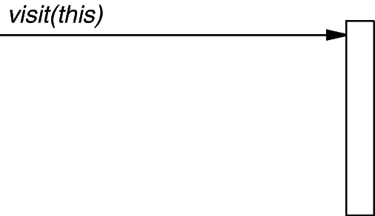
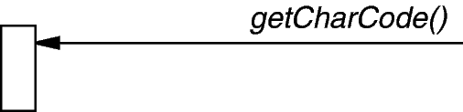
Visitor GoF Object Behavioral
Visitor implementation in C++
The iterator controls the order in which accept() is called on each node in the composition
accept() then “visits” the node to perform the desired print action
Iterator
Leaf_Node(5)
Composite_Negate_Node
print_visitor
accept(print_visitor)
cout<< node.item();
accept(print_visitor)
cout<< ‘-’

Slide 151
Visitor GoF Object Behavioral
Visitor implementation in C++
class Evaluation_Visitor : public ET_Visitor {
public:
virtual void visit (const Leaf_Node &);
virtual void visit (const Add_Node &);
virtual void visit (const Divide_Node &);
// etc.
};
The Evaluation_Visitor class evaluates nodes in an expression tree traversed using a post-order iterator
e.g., 5-34+*

Slide 152
Visitor GoF Object Behavioral
Visitor implementation in C++
class Evaluation_Visitor : public ET_Visitor {
public:
virtual void visit (const Leaf_Node &);
virtual void visit (const Add_Node &);
virtual void visit (const Divide_Node &);
// etc.
private: std::stack<int> stack_;
};
The Evaluation_Visitor class evaluates nodes in an expression tree traversed using a post-order iterator
e.g., 5-34+*
It uses a stack to keep track of the post-order expression tree value that has been processed thus far during the iteration traversal
S = [5] push(node.item())
S = [-5] push(-pop())
S = [-5, 3] push(node.item())
S = [-5, 3, 4] push(node.item())
S = [-5, 7] push(pop()+pop())
S = [-35] push(pop()*pop())

Slide 153
Visitor GoF Object Behavioral
Visitor implementation in C++
The iterator controls the order in which accept() is called on each node in the composition
accept() then “visits” the node to perform the desired evaluation action
Iterator
Leaf_Node(5)
Composite_Negate_Node
eval_visitor
accept(eval_visitor)
stack_.push(node.item());
accept(eval_visitor)
stack_.push(-stack_.pop());

Slide 154
Visitor GoF Object Behavioral
Consequences
Flexibility: Visitor algorithm(s) & object structure are independent
Separation of concerns: Localized functionality in the visitor subclass instance
Tight coupling: Circular dependency between Visitor & Element interfaces
Visitor thus brittle to new ConcreteElement classes

Slide 155
Visitor GoF Object Behavioral
Consequences
Flexibility: Visitor algorithm(s) & object structure are independent
Separation of concerns: Localized functionality in the visitor subclass instance
Tight coupling: Circular dependency between Visitor & Element interfaces
Visitor thus brittle to new ConcreteElement classes
Implementation
Double dispatch
General interface to elements of object structure

Slide 156
Visitor GoF Object Behavioral
Consequences
Flexibility: Visitor algorithm(s) & object structure are independent
Separation of concerns: Localized functionality in the visitor subclass instance
Tight coupling: Circular dependency between Visitor & Element interfaces
Visitor thus brittle to new ConcreteElement classes
Implementation
Double dispatch
General interface to elements of object structure
Known Uses
ProgramNodeEnumerator in Smalltalk-80 compiler
IRIS Inventor scene rendering
TAO IDL compiler to handle different backends

Slide 157
Implementing STL Iterator Semantics
Goals
Ensure the proper semantics of post-increment operations for STL-based ET_Iterator objects, i.e.:
Expression_Tree value = iter++ vs. Expression_Tree value = ++iter

Slide 158
Implementing STL Iterator Semantics
Goals
Ensure the proper semantics of post-increment operations for STL-based ET_Iterator objects
Expression_Tree value = iter++ vs. Expression_Tree value = ++iter
Constraints/forces
STL pre-increment operations are easy to implement since they simply increment the value & return *this, e.g.,
iterator &operator++() { ++...; return *this; }

Slide 159
Implementing STL Iterator Semantics
Goals
Ensure the proper semantics of post-increment operations for STL-based ET_Iterator objects
Expression_Tree value = iter++ vs. Expression_Tree value = ++iter
Constraints/forces
STL pre-increment operations are easy to implement since they simply increment the value & return *this, e.g.,
iterator &operator++() { ++...; return *this; }
STL post-increment operations are more complicated since they return a copy of the existing iterator before incrementing its value, e.g.,
iterator operator++(int)
{ iterator temp = copy_*this; ++...; return temp; }

Slide 160
Implementing STL Iterator Semantics
Goals
Ensure the proper semantics of post-increment operations for STL-based ET_Iterator objects
Expression_Tree value = iter++ vs. Expression_Tree value = ++iter
Constraints/forces
STL pre-increment operations are easy to implement since they simply increment the value & return *this, e.g.,
iterator &operator++() { ++...; return *this; }
STL post-increment operations are more complicated since they return a copy of the existing iterator before incrementing its value, e.g.,
iterator operator++(int)
{ iterator temp = copy_*this; ++...; return temp; }
Since our ET_Iterator objects use the Bridge pattern it is tricky to implement the “copy_*this” step above in a generic way
As a general rule, in STL it’s better to say ++iter than iter++

Slide 161
Solution: Clone a New Instance Via a Prototype
ET_Iterator
operator++(int)
ET_Iterator_Impl
clone()
impl_
In_Order_ET_Iterator_Impl
clone()
Post_Order_ET_Iterator_Impl
clone()
Level_Order_ET_Iterator_Impl
clone()
Pre_Order_ET_Iterator_Impl
clone()
iterator
ET_Iterator::operator++(int)
{
iterator temp(impl_->clone());
++(*impl_);
return temp;
}
The Bridge pattern abstraction class needn’t have direct knowledge of implementor subclass details
Bridge pattern encapsulates variability & simplifies memory management

Slide 162
ET_Iterator_Impl Class Interface
Subclasses of this base class define various iterations algorithms that can traverse an expression tree
Interface
 | ET_Iterator_Impl (const Expression_Tree &tree)
virtual Component_Node * | operator *()=0
void | operator++()=0
virtual bool | operator==(const ET_Iterator_Impl &)=0
virtual bool | operator!= (const ET_Iterator_Impl &)=0
virtual ET_Iterator_Impl * | clone()=0
Subclass performs a deep copy
Commonality: Provides a common interface for expression tree iterator implementations
Variability: Each subclass implements the clone() method to return a deep copy of itself for use by ET_Iterator::operator++(int)

Slide 163
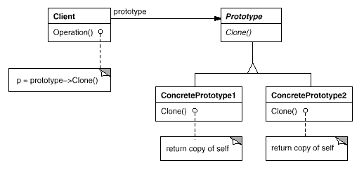
Prototype GoF Object Creational
Intent
Specify the kinds of objects to create using a prototypical instance & create new objects by copying this prototype
Applicability
When the classes to instantiate are specified at run-time
There’s a need to avoid the creation of a factory hierarchy
It is more convenient to copy an existing instance than to create a new one
Structure
e.g., ET_Iterator_Impl
e.g., ET_Iterator
e.g., Pre_Order_ET_Iterator_Impl, In_Order_ET_Iterator_Impl, etc.

Slide 164
Prototype GoF Object Creational
Prototype example in C++
Relationship between iterator interface (Bridge) & implementor hierarchy (Prototype)
iterator
ET_Iterator::operator++(int)
{
iterator temp(impl_->clone());
++(*impl_);
return temp;
}
The Bridge pattern abstraction class calls clone() on the implementor subclass to get a deep copy without breaking encapsulation

Slide 165
Prototype GoF Object Creational
Prototype example in C++
Relationship between iterator interface (Bridge) & implementation (Prototype)
iterator
ET_Iterator::operator++(int)
{
iterator temp(impl_->clone());
++(*impl_);
return temp;
}
ET_Iterator_Impl *Pre_Order_ET_Iterator_Impl::clone() {
return new Pre_Order_ET_Iterator_Impl(*this);
}
This method encapsulates the details of making a deep copy of itself

Slide 166
Prototype GoF Object Creational
Consequences
Can add & remove classes at runtime by cloning them as needed
Reduced subclassing minimizes need for lexical dependencies at run-time
Every class that used as a prototype must itself be instantiated
Classes that have circular references to other classes cannot really be cloned

Slide 167
Prototype GoF Object Creational
Consequences
Can add & remove classes at runtime by cloning them as needed
Reduced subclassing minimizes need for lexical dependencies at run-time
Every class that used as a prototype must itself be instantiated
Classes that have circular references to other classes cannot really be cloned
Implementation
Use prototype manager
Shallow vs. deep copies
Initializing clone internal state within a uniform interface

Slide 168
Prototype GoF Object Creational
Consequences
Can add & remove classes at runtime by cloning them as needed
Reduced subclassing minimizes need for lexical dependencies at run-time
Every class that used as a prototype must itself be instantiated
Classes that have circular references to other classes cannot really be cloned
Implementation
Use prototype manager
Shallow vs. deep copies
Initializing clone internal state within a uniform interface
Known Uses
The first widely known application of the Prototype pattern in an object-oriented language was in ThingLab
Jim Coplien describes idioms related to the Prototype pattern for C++ & gives many examples & variations
Etgdb debugger for ET++
The music editor example is based on the Unidraw drawing framework

Slide 169
Summary of Tree Traversal Patterns
The Iterator, Prototype, & Visitor patterns traverse the expression tree & perform designated operations
Visitor
<< accept >>
ET_Visitor
Expression_Tree
Component_Node
Iterator
<< create >>
ET_Iterator
ET_Iterator_Impl
Evaluation_Visitor
Print_Visitor
std::queue
Level_Order_Expression _Tree_Iterator_Impl
Prototype
In_Order_Expression _Tree_Iterator_Impl
std::stack
Post_Order_Expression _Tree_Iterator_Impl
Pre_Order_Expression _Tree_Iterator_Impl
These patterns allow adding new operations without affecting tree structure

Slide 170
A Case Study of “Gang of Four” (GoF) Patterns : Part 8
Douglas C. Schmidt
d.schmidt@vanderbilt.edu
www.dre.vanderbilt.edu/~schmidt
Professor of Computer Science
Institute for Software Integrated Systems Vanderbilt University Nashville, Tennessee, USA

Slide 171
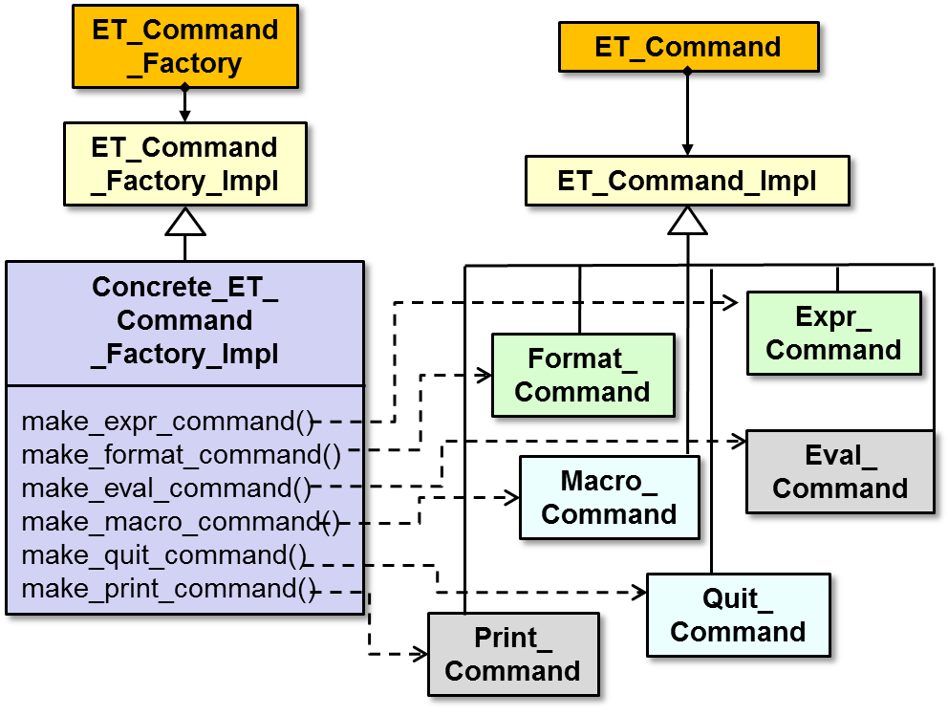
Topics Covered in this Part of the Module
Describe the object-oriented (OO) expression tree case study
Evaluate the limitations with algorithmic design techniques
Present an OO design for the expression tree processing app
Summarize the patterns in the expression tree design
Explore patterns for
Tree structure & access
Tree creation
Tree traversal
Commands & factories
ET_Command _Factory
ET_Command
ET_Command _Factory_Impl
ET_Command_Impl
Expr_ Command
Format_ Command
Eval_ Command
Macro_ Command
Quit_ Command
Print_ Command

Slide 172
Overview of Command & Factory Patterns
Purpose: Define operations that can users can perform on an expression tree processing app & centralize extensible creation of these operations
Abstract Factory & Factory Method
ET_Event_Handler
ET_Command_Factory
ET_Command _Factory_Impl
<< create >>
Concrete_ET_ Command_Factory_Impl
ET_Context
*
ET_Command
ET_Command_Impl
Command
1
Macro_Command
Print_Command
Set_Command
Quit_Command
Null_Command
Format_Command
Expr_Command
Eval_Command
These patterns decouple creation from use & provide a uniform command API

Slide 173
Problem: Consolidating User Operations
Goals
Support execution of user operations
% tree-traversal -v
format [in-order]
expr [expression]
print [in-order|pre-order|post- order|level-order]
eval [post-order]
quit
> format in-order
> expr 1+4*3/2
> eval post-order
7
> quit
% tree-traversal
> 1+4*3/2
7
Verbose mode

Slide 174
Problem: Consolidating User Operations
Goals
Support execution of user operations
Support macro operations
% tree-traversal -v
format [in-order]
expr [expression]
print [in-order|pre-order|post- order|level-order]
eval [post-order]
quit
> format in-order
> expr 1+4*3/2
> eval post-order
7
> quit
% tree-traversal
> 1+4*3/2
7
Succinct mode

Slide 175
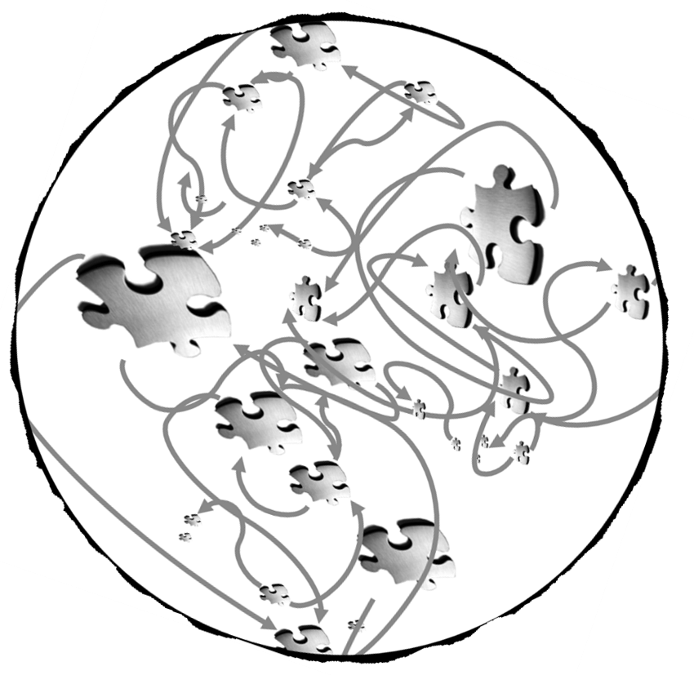
Problem: Consolidating User Operations
Goals
Support execution of user operations
Support macro operations
Constraints/forces
Avoid scattering the implementation of operations throughout the source code
Ensure consistent memory management

Slide 176
Solution: Encapsulate an Operation w/Command
A Command encapsulates
An operation method (execute())
An inverse operation method (unexecute())
A test for reversibility (boolean reversible())
State for (un)doing the operation
ET_Command
ET_Command_Impl
Expr_ Command
Format_ Command
Eval_ Command
Macro_ Command
Quit_ Command
Print_ Command

Slide 177
Solution: Encapsulate an Operation w/Command
A Command encapsulates
An operation method (execute())
An inverse operation method (unexecute())
A test for reversibility (boolean reversible())
State for (un)doing the operation
A Command may
Implement the operation itself or
Forward the operation implementation to other object(s)
ET_Command
ET_Command_Impl
Expr_ Command
Format_ Command
Eval_ Command
Macro_ Command
Quit_ Command
Print_ Command
Bridge pattern encapsulates variability & simplifies memory management

Slide 178
ET_Command Class Interface
Interface for defining a command that—when executed—performs an operation on an expression tree
This class plays the role of the abstraction in the Bridge pattern
Interface
 | ET_Command(ET_Command_Impl *=0)
 | ET_Command(const ET_Command &)
ET_Command & | operator=(const ET_Command &)
 | ~ET_Command()
bool | execute()
bool | unexecute()
These methods forward to the implementor subclass
We don’t use this method but it’s a common command feature
Commonality: Provides common interface for expression tree commands
Variability: Implementations of expression tree commands can vary depending on the operations requested by user input

Slide 179
ET_Command_Impl Class Interface
Base class of an implementor hierarchy used to define commands that perform operations on an expression tree when they are executed
This class is the base class of the implementor hierarchy in the Bridge pattern
Interface
 | ET_Command_Impl(ET_Context &)
 | ~ET_Command_Impl()= 0
 | ...
virtual bool | execute()=0
virtual bool | unexecute()=0
The bulk of the work is typically done here by subclasses
Commonality: Provides a common base class for implementations of expression tree commands
Variability: Subclasses of this base class implement different expression tree commands depending on the operations requested by user input

Slide 180
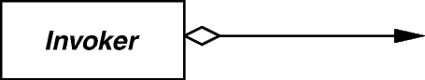
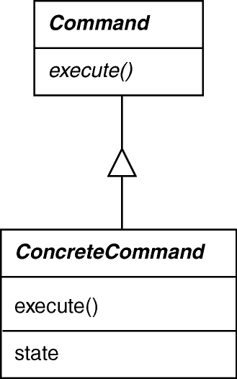
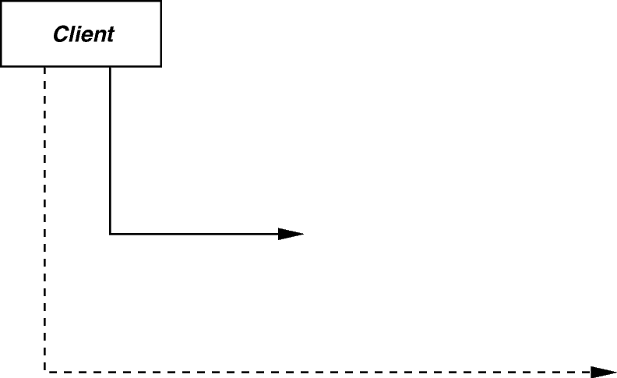
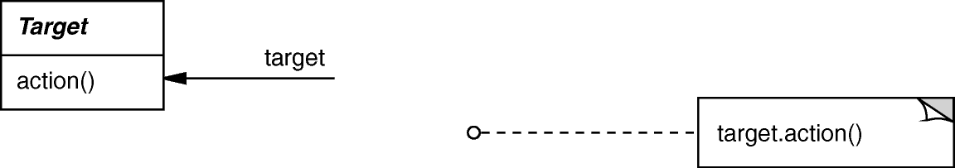
Command GoF Object Behavioral
Intent
Encapsulate the request for a service as an object
Applicability
Want to parameterize objects with an action to perform
Want to specify, queue, & execute requests at different times
For multilevel undo/redo
e.g., ET_Command_Impl
Structure
e.g., Eval_Command, Format_Command, Print_Command, Quit_Command, Macro_Command, etc.

Slide 181
Command GoF Object Behavioral
Command example in C++
Encapsulate execution of a sequence of commands as an object
class Macro_Command : public ET_Command_Impl {
public:
...
bool execute() {
std::for_each (macro_commands_.begin(),
macro_commands_.end(),
std::mem_fun_ref(&ET_Command::execute));
return true;
}
private:
std::vector <ET_Command> macro_commands_;
...
Executes a sequence of commands (used to implement “succinct mode”)
Vector of commands to execute as a macro

Slide 182
Command GoF Object Behavioral
Command example in C++
Encapsulate execution of a sequence of commands as an object
class Macro_Command : public ET_Command_Impl {
public:
...
bool execute() {
std::for_each (macro_commands_.begin(),
macro_commands_.end(),
std::mem_fun_ref(&ET_Command::execute));
return true;
}
private:
std::vector <ET_Command> macro_commands_;
...
STL for_each() algorithm
Application of the Adapter pattern
Vector of commands to execute as a macro

Slide 183
Command GoF Object Behavioral
Command example in C++
Encapsulate execution of a sequence of subcommands as an object
class Macro_Command : public ET_Command_Impl {
public:
...
bool execute() {
std::for_each (macro_commands_.begin(),
macro_commands_.end(),
[](ET_Command &c){ c.execute(); });
return true;
}
private:
std::vector <ET_Command> macro_commands_;
...
C++11 lambda expression

Slide 184
Command GoF Object Behavioral
Command example in C++
Encapsulate execution of a sequence of subcommands as an object
class Macro_Command : public ET_Command_Impl {
public:
...
bool execute() {
for (auto &iter = macro_commands_)
iter.execute();
return true;
}
private:
std::vector <ET_Command> macro_commands_;
...
C++11 range-based for loop

Slide 185
Command GoF Object Behavioral
Consequences
Abstracts executor of a service
Supports arbitrary-level undo-redo
Composition yields macro-commands
Might result in lots of trivial command subclasses
Excessive memory may be needed to support undo/redo operations

Slide 186
Command GoF Object Behavioral
Consequences
Abstracts executor of a service
Supports arbitrary-level undo-redo
Composition yields macro-commands
Might result in lots of trivial command subclasses
Excessive memory may be needed to support undo/redo operations
Implementation
Copying a command before putting it on a history list
Avoiding error accumulation during undo/redo
Supporting transactions

Slide 187
Command GoF Object Behavioral
Consequences
Abstracts executor of a service
Supports arbitrary-level undo-redo
Composition yields macro-commands
Might result in lots of trivial command subclasses
Excessive memory may be needed to support undo/redo operations
Implementation
Copying a command before putting it on a history list
Avoiding error accumulation during undo/redo
Supporting transactions
Known Uses
InterViews Actions
MacApp, Unidraw Commands
JDK’s UndoableEdit, AccessibleAction
Emacs
Microsoft Office tools
See Also
Command Processor pattern in POSA1

Slide 188
Problem: Consolidating Creation of Variabilities
Goals
Simplify & centralize the creation of all variabilities in the expression tree application to ensure semantic compatibility
Be extensible for future variabilities
ET_Command
ET_Command_Impl
Format_Command
Print_Command
Eval_Command
Quit_Command
Expr_Command
Macro_Command
ET_Iterator
ET_Iterator_Impl
In_Order_ET_Iterator_Impl
Post_Order_ET_Iterator_Impl
Level_Order_ET_Iterator_Impl
Pre_Order_ET_Iterator_Impl

Slide 189
Problem: Consolidating Creation of Variabilities
Goals
Simplify & centralize the creation of all variabilities in the expression tree application to ensure semantic compatibility
Be extensible for future variabilities
Constraints/forces
Don’t recode existing clients
Add new variabilities without recompiling
ET_Command
ET_Command_Impl
Format_Command
Print_Command
Eval_Command
Quit_Command
Expr_Command
Macro_Command
ET_Iterator
ET_Iterator_Impl
In_Order_ET_Iterator_Impl
Post_Order_ET_Iterator_Impl
Level_Order_ET_Iterator_Impl
Pre_Order_ET_Iterator_Impl

Slide 190
Solution: Abstract Object Creation
Factory
Instead of
ET_Command command(new Print_Command());
Use
ET_Command command
(command_factory.make_command("print"));
where command_factory is an instance of ET_Command_Factory
Hard-codes a lexical dependency on Print_Command
No lexical dependency on any concrete class

Slide 191
Solution: Abstract Object Creation
Factory
Instead of
ET_Command command(new Print_Command());
Use
ET_Command command
(command_factory.make_command("print"));
where command_factory is an instance of ET_Command_Factory
Factory structure
ET_Command_Factory
ET_Command_Factory_Impl
Concrete_ET_Command _Factory_Impl
Bridge pattern encapsulates variability & simplifies memory management

Slide 192
ET_Command_Factory Class Interface
Interface used to create appropriate command based on string supplied by caller
This class plays the role of the abstraction in the Bridge pattern
Interface
 | ET_Command_Factory(ET_Context &tree_context)
 | ET_Command_Factory(ET_Command_Factory_Impl *)
ET_Command | make_command(const std::string &s) ...
ET_Command | make_format_command(const std::string &)
ET_Command | make_expr_command(const std::string &)
ET_Command | make_print_command(const std::string &)
ET_Command | make_eval_command(const std::string &)
ET_Command | make_quit_command(const std::string &)
ET_Command | make_macro_command(const std::string &)
These are helper factory methods
This is the main factory method
Commonality: Provides a common interface to create commands
Variability: Implementations of expression tree command factory methods can vary depending on the requested commands

Slide 193
ET_Command_Factory_Impl Class Interface
Base class of an implementor hierarchy used to create appropriate commands based on string supplied by caller
This class is base class of implementor hierarchy in the Bridge pattern
Interface
 | ET_Command_Factory_Impl(ET_Context &context)
 | ~ET_Command_Factory_Impl()
virtual ET_Command | make_command(const std::string &s)=0 ...
virtual ET_Command | make_format_command(const std::string &)=0
virtual ET_Command | make_expr_command(const std::string &)=0
virtual ET_Command | make_print_command(const std::string &)=0
virtual ET_Command | make_eval_command(const std::string &)=0
virtual ET_Command | make_quit_command(const std::string &)=0
virtual ET_Command | make_macro_command(const std::string &)=0
Pure virtual methods
Commonality: Provides a common interface to create commands
Variability: Subclasses of this base class define expression tree command factory methods vary depending on the requested commands

Slide 194
Factory Structure
ET_Command_Factory
ET_Command
ET_Command_Factory_Impl
ET_Command_Impl
Concrete_ET_Command _Factory_Impl
+make_command()
#make_expr_command()
#make_format_command()
#make_eval_command()
#make_macro_command()
#make_quit_command()
#make_print_command()
Expr_ Command
Format_ Command
Eval_ Command
Macro_ Command
Quit_ Command
Print_ Command
Each factory method creates a different type of concrete command
Bridge pattern encapsulates variability & simplifies memory management

Slide 195
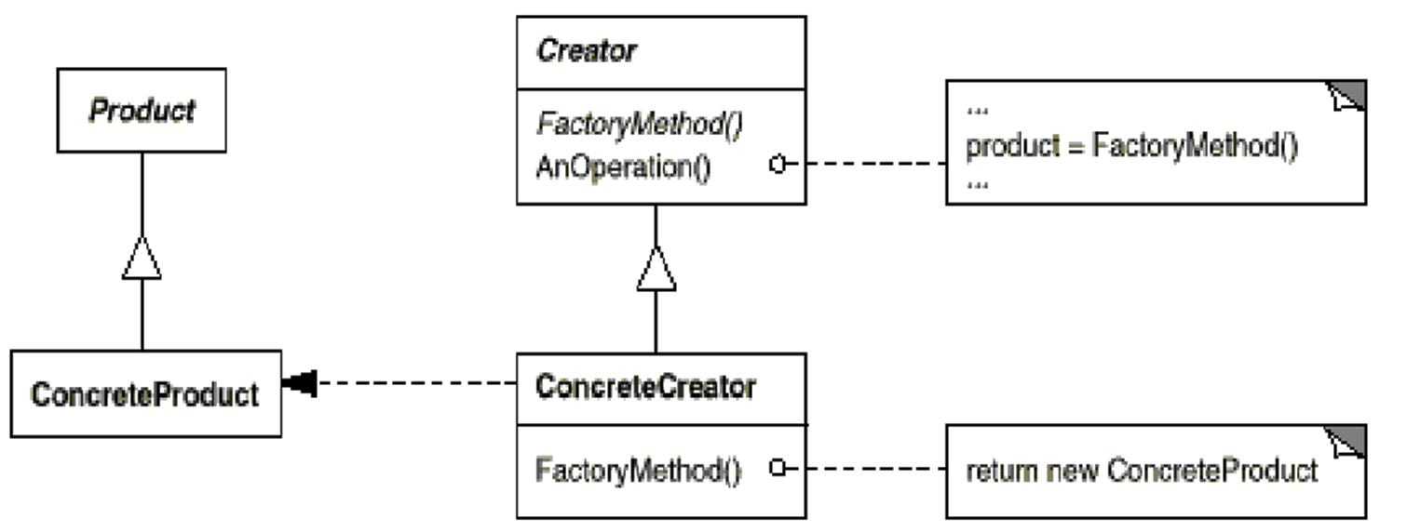
Factory Method GoF Class Creational
Intent
Provide an interface for creating an object, but leave choice of object’s concrete type to a subclass
Applicability
When a class cannot anticipate the objects it must create or a class wants its subclasses to specify the objects it creates
e.g., ET_Command_Impl
e.g., ET_Command _Factory_Impl
Structure
e.g., Concrete_ET_ Command_Factory_Impl
e.g., Eval_Command, Print_ Command, Macro_Command, etc.

Slide 196
Factory Method GoF Class Creational
Factory Method example in C++
An interface for creating a command, letting subclass chose concrete type
class ET_Command_Factory_Impl { public: virtual ET_Command make_macro_command(const std::string &) = 0; ...
Pure virtual method

Slide 197
Factory Method GoF Class Creational
Factory Method example in C++
An interface for creating a command, letting subclass chose concrete type
class ET_Command_Factory_Impl { public: virtual ET_Command make_macro_command(const std::string &) = 0; ...
class Concrete_ET_Command_Factory_Impl : public ET_Command_Factory_Impl {
public:
virtual ET_Command make_macro_command(const std::string &expr) {
std::vector <ET_Command> commands;
commands.push_back(make_format_command("in-order"));
commands.push_back(make_expr_command(expr));
commands.push_back(make_eval_command("post-order"));
return ET_Command(new Macro_Command(tree_context_, commands));
}
Used to implement “succinct mode”
Create vector of commands that are executed as a macro
Encapsulates command within Bridge abstraction object

Slide 198
Factory Method GoF Class Creational
Consequences
+ Flexibility: The client becomes more flexible by not specifying the class name of the concrete class & the details of its creation
+ Decoupling: The client only depends on the interface
More classes: Construction of objects requires an additional class in some cases

Slide 199
Factory Method GoF Class Creational
Consequences
+ Flexibility: The client becomes more flexible by not specifying the class name of the concrete class & the details of its creation
+ Decoupling: The client only depends on the interface
More classes: Construction of objects requires an additional class in some cases
Implementation
There are two choices
The creator class is abstract & does not implement creation methods (then it must be subclassed)
The creator class is concrete & provides a default implementation (then it can be subclassed)
If a factory method can create different variants the method should be passed a parameter to designate the variant

Slide 200
Factory Method GoF Class Creational
Consequences
+ Flexibility: The client becomes more flexible by not specifying the class name of the concrete class & the details of its creation
+ Decoupling: The client only depends on the interface
More classes: Construction of objects requires an additional class in some cases
Implementation
There are two choices
The creator class is abstract & does not implement creation methods (then it must be subclassed)
The creator class is concrete & provides a default implementation (then it can be subclassed)
If a factory method can create different variants the method must be provided with a parameter
Known Uses
InterViews Kits
ET++ WindowSystem
AWT Toolkit
The ACE ORB (TAO)
BREW feature phone frameworks

Slide 201
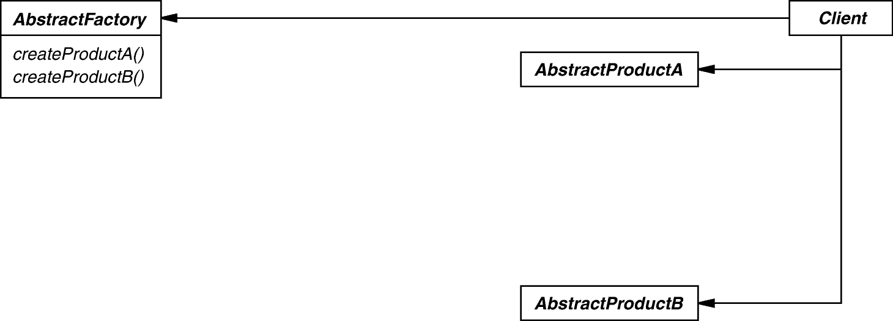
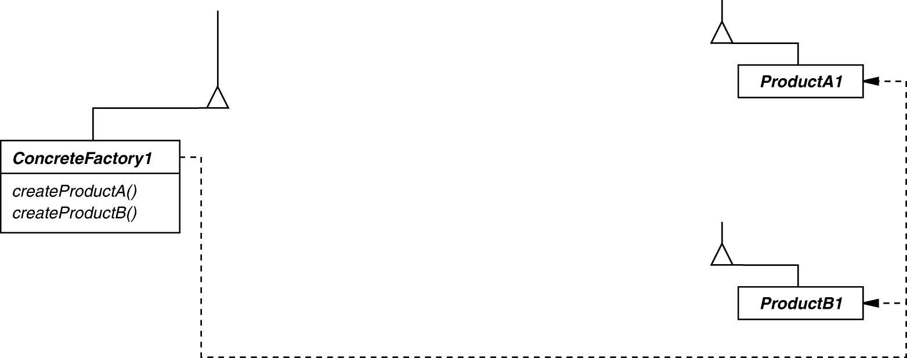
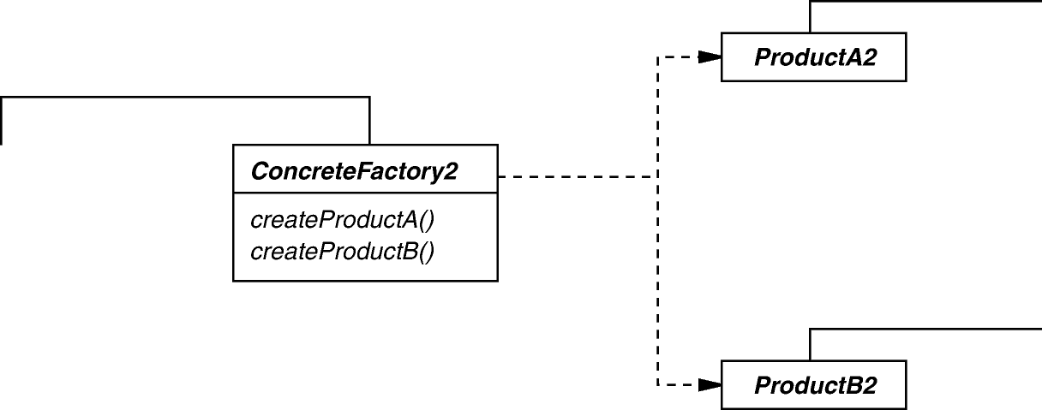
Abstract Factory GoF Object Creational
Intent
Create families of related objects without specifying subclass names
Applicability
When clients cannot anticipate groups of classes to instantiate
Structure
e.g., ET_Command _Impl
e.g., ET_Command _Factory_Impl
e.g., Eval_Command, Print_ Command, Macro_Command, etc.
e.g., Concrete_ET_ Command_Factory_Impl

Slide 202
Abstract Factory GoF Object Creational
Abstract Factory example in C++
Create families of related objects without specifying subclass names
class Concrete_ET_Command_Factory_Impl : public ET_Command_Factory_Impl {
public: Concrete_ET_Command_Factory_Impl() {
command_map_["format"] = &make_format_command;
command_map_["expr"] = &make_expr_command;
command_map_["eval"] = &make_eval_command;
...
std::map associating command names to pointer-to-member-function command factories

Slide 203
Abstract Factory GoF Object Creational
Abstract Factory example in C++
Create families of related objects without specifying subclass names
class Concrete_ET_Command_Factory_Impl : public ET_Command_Factory_Impl {
public: Concrete_ET_Command_Factory_Impl() {
command_map_["format"] = &make_format_command;
command_map_["expr"] = &make_expr_command;
command_map_["eval"] = &make_eval_command;
...
virtual ET_Command make_command(const std::string &input) {
auto iter = command_map_.find(command_name(input));
if (iter != command_map_.end()) { auto ptmf = iter->second;
return (this->*ptmf)(command_parameter(input));
}
...
The primary factory method that creates the designated command based on user input
Dispatch command factory method via returned via map

Slide 204
Abstract Factory GoF Object Creational
Consequences
Flexibility: Removes type (i.e., subclass) dependencies from clients
Abstraction & semantic checking: Encapsulates product’s composition
Complexity: Tedious to extend factory interface to create new products

Slide 205
Abstract Factory GoF Object Creational
Consequences
Flexibility: Removes type (i.e., subclass) dependencies from clients
Abstraction & semantic checking: Encapsulates product’s composition
Complexity: Tedious to extend factory interface to create new products
Implementation
Parameterization as a way of controlling interface size
Configuration with prototypes to determine who creates the factories
Abstract factories are essentially groups of factory methods

Slide 206
Abstract Factory GoF Object Creational
Consequences
Flexibility: Removes type (i.e., subclass) dependencies from clients
Abstraction & semantic checking: Encapsulates product’s composition
Complexity: Tedious to extend factory interface to create new products
Implementation
Parameterization as a way of controlling interface size
Configuration with prototypes to determine who creates the factories
Abstract factories are essentially groups of factory methods
Known Uses
InterViews Kits
ET++ WindowSystem
AWT Toolkit
The ACE ORB (TAO)

Slide 207
Summary of Command & Factory Patterns
Abstract Factory contains Factory Methods that create Command objects, which then dictate how users interact with an expression tree processing app
Abstract Factory & Factory Method
ET_Event_Handler
ET_Command_Factory
ET_Command_Factory_Impl
<< create >>
Concrete_ET_Command_Factory_Impl
ET_Context
*
ET_Command
ET_Command_Impl
Command
1
Macro_Command
Print_Command
Set_Command
Quit_Command
Null_Command
Format_Command
Expr_Command
Eval_Command
These patterns enable extensibility of operations via new factory methods

Slide 208
A Case Study of “Gang of Four” (GoF) Patterns : Part 9
Douglas C. Schmidt
d.schmidt@vanderbilt.edu
www.dre.vanderbilt.edu/~schmidt
Professor of Computer Science
Institute for Software Integrated Systems Vanderbilt University Nashville, Tennessee, USA

Slide 209
Topics Covered in this Part of the Module
Describe the object-oriented (OO) expression tree case study
Evaluate the limitations with algorithmic design techniques
Present an OO design for the expression tree processing app
Summarize the patterns in the expression tree design
Explore patterns for
Tree structure & access
Tree creation
Tree traversal
Commands & factories
Command ordering protocols
Uninitialized State
format()
make_tree()
*_Order_ Uninitialized State
*_Order_ Initialized State
format()
print()
quit()
make_tree()
eval()

Slide 210
Overview of a Command Protocol Pattern
Purpose: Ensure user commands are performed in the correct order
ET_Context
ET_State
Uninitialized _State
Pre_Order_
Uninitialized_State
Post_Order_
Uninitialized_State
In_Order_
Uninitialized_State
Level_Order_
Uninitialized_State
Pre_Order_
Initialized_State
Post_Order_
Initialized_State
In_Order_
Initialized_State
Level_Order_
Initialized_State
State
<< use >>
ET_Interpreter
This pattern uses design of classes to explicitly order user commands correctly

Slide 211
Problem: Ensuring Correct Command Protocol
Goals
Ensure that users follow the correct protocol when entering commands
% tree-traversal -v
format [in-order]
expr [expression]
print [in-order|pre-order|post- order|level-order]
eval [post-order]
quit
> format in-order
> print in-order
Error: ET_State::print called in invalid state
Protocol violation

Slide 212
Problem: Ensuring Correct Command Protocol
Goals
Ensure that users follow the correct protocol when entering commands
Constraints/forces
Must consider context of previous commands to determine protocol conformance, e.g.,
format must be called first
expr must be called before print or eval
print & eval can be called in any order
% tree-traversal -v
format [in-order]
expr [expression]
print [in-order|pre-order|post- order|level-order]
eval [post-order]
quit
> format in-order
> print in-order
Error: ET_State::print called in invalid state
Protocol violation

Slide 213
Solution: Encapsulate Command History as States
Handling user commands depends on history of prior commands
This history can be represented as a state machine
Uninitialized State
format()
Uninitialized State
*_Order_ Uninitialized State
make_tree()
*_Order_ Initialized State
format()
print()
quit()
make_tree()
eval()

Slide 214
Solution: Encapsulate Command History as States
Handling user commands depends on history of prior commands
This history can be represented as a state machine
Uninitialized State
format()
Uninitialized State
*_Order_ Uninitialized State
make_tree()
*_Order_ Initialized State
format()
print()
quit()
make_tree()
eval()

Slide 215
Solution: Encapsulate Command History as States
Handling user commands depends on history of prior commands
This history can be represented as a state machine
Uninitialized State
format()
Uninitialized State
*_Order_ Uninitialized State
make_tree()
*_Order_ Initialized State
format()
print()
quit()
make_tree()
eval()

Slide 216
Solution: Encapsulate Command History as States
Handling user commands depends on history of prior commands
This history can be represented as a state machine
Uninitialized State
format()
Uninitialized State
*_Order_ Uninitialized State
make_tree()
*_Order_ Initialized State
format()
print()
quit()
make_tree()
eval()

Slide 217
Solution: Encapsulate Command History as States
Handling user commands depends on history of prior commands
This history can be represented as a state machine
Uninitialized State
format()
Uninitialized State
*_Order_ Uninitialized State
make_tree()
*_Order_ Initialized State
format()
print()
quit()
make_tree()
eval()

Slide 218
Solution: Encapsulate Command History as States
Handling user commands depends on history of prior commands
This history can be represented as a state machine
Uninitialized State
format()
Uninitialized State
*_Order_ Uninitialized State
make_tree()
*_Order_ Initialized State
format()
print()
quit()
make_tree()
eval()

Slide 219
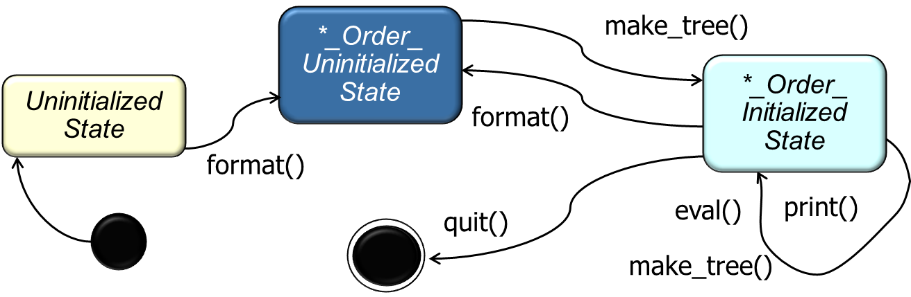
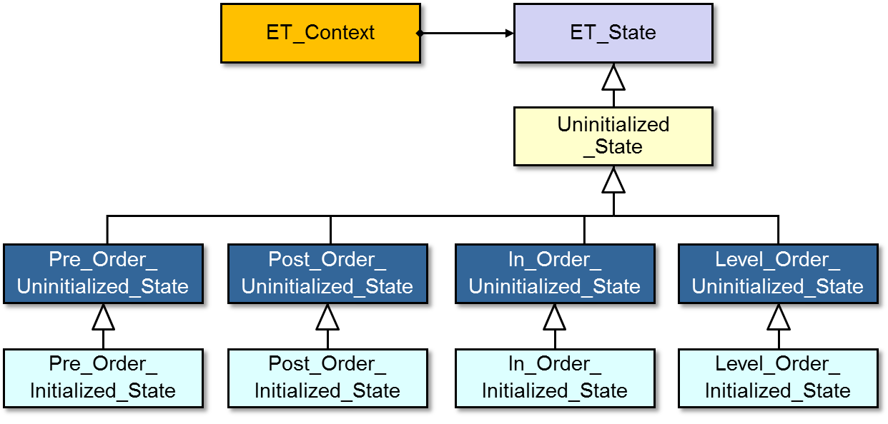
Solution: Encapsulate Command History as States
Handling user commands depends on history of prior commands
This history can be represented as a state machine
The state machine can be encoded using various subclasses that enforce the correct protocol for user commands
*_Order_ Uninitialized State
make_tree()
*_Order_ Initialized State
Uninitialized State
format()
format()
quit()
eval()
print()
make_tree()
ET_Context also encapsulates variability & simplifies memory management

Slide 220
ET_Context Class Interface
Interface used to ensure commands are invoked according to correct protocol
These methods correspond to user commands
Interface
void | format(const std::string &new_format)
void | make_tree(const std::string &expression)
void | print(const std::string &format)
void | evaluate(const std::string &format) ...
ET_State * | state() const
void | state(ET_State *new_state)
Expression_Tree & | tree()
void | tree(const Expression_Tree &new_tree)
Setter/getter for ET_State subclasses
Commonality: Provides a common interface for ensuring that expression tree commands are invoked according to the correct protocol
Variability: The implementations—& correct functioning—of the expression tree commands can vary depending on the requested operations & the current state

Slide 221
ET_State Class Interface
Implementation used to define the various states that affect how users commands are processed
These methods are delegated from ET_Context methods
Interface
virtual void | format(ET_Context &context, const std::string &new_format)
virtual void | make_tree(ET_Context &context, const std::string &expression)
virtual void | print(ET_Context &context, const std::string &format)
virtual void | evaluate(ET_Context &context, const std::string &format)
Commonality: Provides a common interface for ensuring that expression tree commands are invoked according to the correct protocol
Variability: The implementations—& correct functioning—of the expression tree commands can vary depending on the requested operations & the current state

Slide 222
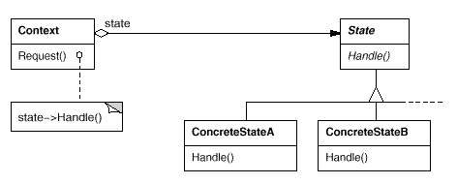
State GoF Object Behavioral
Intent
Allow an object to alter its behavior when its internal state changes—the object will appear to change its class
Applicability
When an object must change its behavior at run-time depending on which state it is in
When several operations have the same large multipart conditional structure that depends on the object's state
e.g., ET_State
Structure
e.g., Uninitialized_State, Pre_Order_Uninitialized_State, Pre_Order_Initialized_State, etc.
e.g., ET_Context

Slide 223
State GoF Object Behavioral
State example in C++
Allows ET_Context object to alter its behavior when its state changes
void
ET_Context::make_tree(const std::string &expression) {
state_->make_tree(*this, expression);
}
class Uninitialized_State { public: virtual void make_tree(ET_Context &tc, const std::string &expr) { throw Invalid_State("make_tree called in invalid state"); } ...
This method delegates to the ET_State object
It’s invalid to call make_tree() in this state

Slide 224
State GoF Object Behavioral
State example in C++
Allows ET_Context object to alter its behavior when its state changes
void
ET_Context::make_tree(const std::string &expression) {
state_->make_tree(*this, expression);
}
class In_Order_Uninitialized_State : public Uninitialized_State { public:
virtual void make_tree(ET_Context &et_context, const std::string &expr) {
ET_Interpreter interp; ET_Interpreter_Context interp_context;
et_context.tree(interp.interpret (interp_context, expr));
et_context.state(new In_Order_Initialized_State);
}
...
This method delegates to the ET_State object
Calling make_tree() in this state initializes expression tree
Transition to the new state

Slide 225
State GoF Object Behavioral
Consequences
It localizes state-specific behavior & partitions behavior for different states
It makes state transitions explicit
State objects can be shared
Can result in lots of subclasses that are hard to understand

Slide 226
State GoF Object Behavioral
Consequences
It localizes state-specific behavior & partitions behavior for different states
It makes state transitions explicit
State objects can be shared
Can result in lots of subclasses that are hard to understand
Implementation
Who defines state transitions?
Consider using table-based alternatives
Creating & destroying state objects

Slide 227
State GoF Object Behavioral
Consequences
It localizes state-specific behavior & partitions behavior for different states
It makes state transitions explicit
State objects can be shared
Can result in lots of subclasses that are hard to understand
Implementation
Who defines state transitions?
Consider using table-based alternatives
Creating & destroying state objects
Known Uses
The State pattern & its application to TCP connection protocols are characterized by Ralph Johnson & Johnny Zweig in their article “Delegation in C++. Journal of Object-Oriented Programming,” 4(11):22-35, November 1991
Unidraw & Hotdraw drawing tools

Slide 228
Summary of State Pattern
State ensures user commands are performed in the correct order
ET_Context
ET_State
Uninitialized _State
Pre_Order_
Uninitialized_State
Post_Order_
Uninitialized_State
In_Order_
Uninitialized_State
Level_Order_
Uninitialized_State
Pre_Order_
Initialized_State
Post_Order_
Initialized_State
In_Order_
Initialized_State
Level_Order_
Initialized_State
State
<< use >>
ET_Interpreter
This pattern uses design of classes to explicitly order user commands correctly

Slide 229
A Case Study of “Gang of Four” (GoF) Patterns : Part 10
Douglas C. Schmidt
d.schmidt@vanderbilt.edu
www.dre.vanderbilt.edu/~schmidt
Professor of Computer Science
Institute for Software Integrated Systems Vanderbilt University Nashville, Tennessee, USA

Slide 230
Topics Covered in this Part of the Module
Describe the object-oriented (OO) expression tree case study
Evaluate the limitations with algorithmic design techniques
Present an OO design for the expression tree processing app
Summarize the patterns in the expression tree design
Explore patterns for
Tree structure & access
Tree creation
Tree traversal
Commands & factories
Command ordering protocols
Application structure
Reactor
register_handler()
remove_handler()
run_event_loop()
end_event_loop()
Event_Handler
ET_Event_Handler
Verbose_ET_ Event_Handler
Succinct_ET_ Event_Handler

Slide 231
Overview of Application Structure Patterns
Purpose: Structure the overall control flow of the event-driven expression tree processing app
Reactor
Singleton
Reactor
Event_Handler
Options
ET_Command_Factory
ET_Event_Handler
ET_Context
<< create >>
Verbose_ET_ Event_Handler
Succinct_ET_ Event_Handler
ET_Command
These patterns simplify processing of events & user options

Slide 232



Problem: Structuring Application Event Flow
Goals
Decouple expression tree processing app from the context in which it runs
e.g., command-line vs. various GUI environments
% tree-traversal -v
format [in-order]
expr [expression]
print [in-order|pre-order|post-order|level-order]
eval [post-order]
quit
> format in-order
> expr 1+4*3/2
> eval post-order
7
> quit

Slide 233
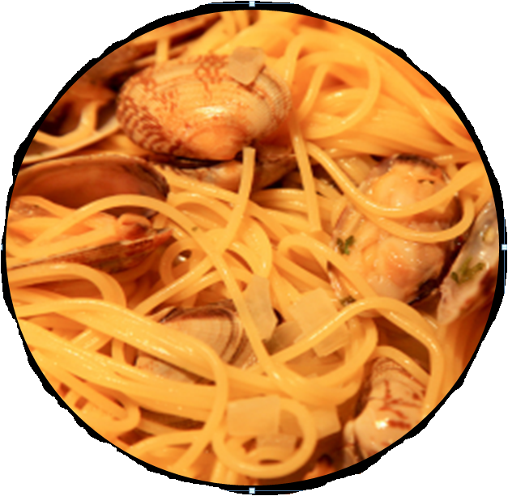
Problem: Structuring Application Event Flow
Goals
Decouple expression tree processing app from the context in which it runs
e.g., command-line vs. various GUI environments
Constraints/forces
Don’t hard-code control flow into app logic
Don’t hard-code event processing logic into app structure

Slide 234
Solution: Separate Event Handling Concerns
Create a reactor to detect input on various sources of events
Reactor
register_handler()
remove_handler()
run_event_loop()
end_event_loop()

Slide 235
Solution: Separate Event Handling Concerns
Create a reactor to detect input on various sources of events & then demux & dispatch the events to the appropriate event handlers
Event_Handler
Reactor
register_handler()
remove_handler()
run_event_loop()
end_event_loop()
ET_Event_Handler
Verbose_ET_ Event_Handler
Succinct_ET_ Event_Handler

Slide 236
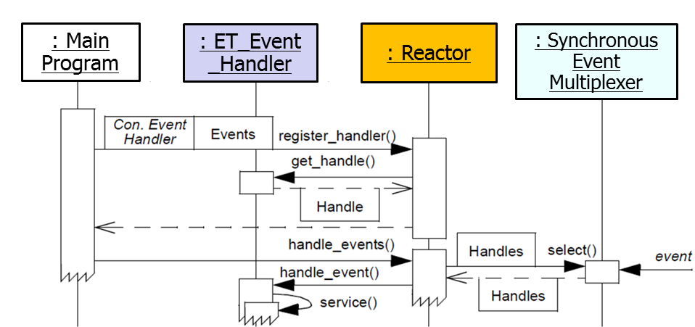
Solution: Separate Event Handling Concerns
Create a reactor to detect input on various sources of events & then demux & dispatch the events to the appropriate event handlers
Create concrete event handlers & register the concrete event handlers with the reactor
Event handlers perform various operation modes of the expression tree processing app

Slide 237
Solution: Separate Event Handling Concerns
Create a reactor to detect input on various sources of events & then demux & dispatch the events to the appropriate event handlers
Create concrete event handlers & register the concrete event handlers with the reactor
Run the reactor’s event loop to drive the application event flow
Note the inversion of control

Slide 238
Reactor & Event Handler Class Interfaces
An object-oriented event demultiplexor & dispatcher of event handler callback methods in response to various types of events
Interface
Enact “inversion of control”
 | ~Reactor()
void | run_event_loop()
void | end_event_loop()
void | register_handler(Event_Handler *event_handler)
void | remove_handler(Event_Handler *event_handler)
static Reactor * | instance()
Singleton access point
Attach/detact event handlers

Slide 239
Reactor & Event Handler Class Interfaces
An object-oriented event demultiplexor & dispatcher of event handler hook methods in response to various types of events
Interface
virtual void | ~Event_Handler()=0
virtual void | delete_this()
virtual void | handle_input()=0
<<uses>>
 | ~Reactor()
void | run_event_loop()
void | end_event_loop()
void | register_handler(Event_Handler *event_handler)
void | remove_handler(Event_Handler *event_handler)
static Reactor * | instance()
Process an event
Commonality: Provides a common interface for managing & processing events via callbacks to abstract event handlers
Variability: Concrete implementations of Reactor & event handlers can be tailored to a wide range of OS muxing mechanisms & application-specific concrete event handling behaviors

Slide 240
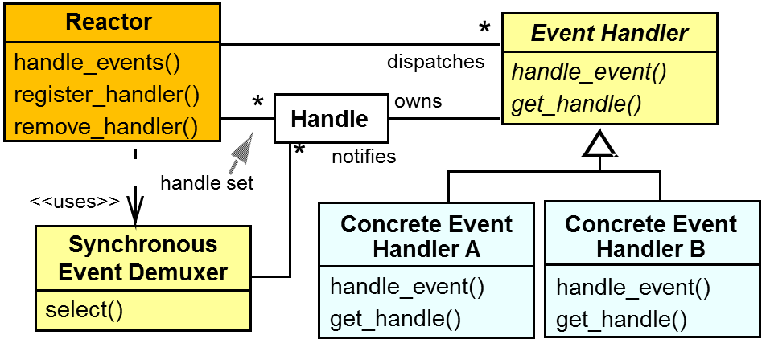
Reactor POSA2 Architectural Pattern
Intent
Allows event-driven applications to demultiplex & dispatch service requests that are delivered to an application from one or more clients
Applicability
Need to decouple event handling from event management infrastructure
When multiple sources of events must be handled in a single thread
Structure
e.g., Event_Handler
e.g., Verbose_ET _Event_Handler, Succinct_ET_ Event_Handler
See www.dre.vanderbilt.edu/~schmidt/PDF/Reactor.pdf for the Reactor pattern

Slide 241
Reactor POSA2 Architectural Pattern
Reactor example in C++
Detect/demux events & dispatch event handler callback methods in response
class Reactor {
public:
static Reactor *instance();
void run_event_loop() {
while (run_event_loop_)
wait_for_next_event()->handle_input();
}
void register_input_handler(Event_Handler *event_handler) {
dispatch_table_.push_back(eh);
}
...
private:
std::vector <Event_Handler *> dispatch_table_;
...
Singleton access point
Run the app event loop
Register an event handler for input events in dispatch table

Slide 242
Reactor POSA2 Architectural Pattern
Consequences
Separation of concerns & portability
Simplify concurrency control
Non-preemptive
Scalability issues

Slide 243
Reactor POSA2 Architectural Pattern
Consequences
Separation of concerns & portability
Simplify concurrency control
Non-preemptive
Scalability issues
Implementation
Decouple event detection/demuxing mechanisms from event dispatching
e.g., via Bridge
Handle many different types of events
e.g., input/output events, signals, timers, etc.

Slide 244
Reactor POSA2 Architectural Pattern
Consequences
Separation of concerns & portability
Simplify concurrency control
Non-preemptive
Scalability issues
Implementation
Decouple event detection/demuxing mechanisms from event dispatching
e.g., via Bridge
Handle many different types of events
e.g., input/output events, signals, timers, etc.
Known Uses
X Windows Xt
InterViews Dispatcher
ET++ WindowSystem
AWT Toolkit
ACE & The ACE ORB (TAO)
Java NIO package
See gee.cs.oswego.edu/dl/cpjslides/nio.pdf for Java Reactor info

Slide 245
Problem: Managing Access to Global Resources
Goals
Centralize access to resources that should be visible globally, e.g.:
Command-line options that parameterize the program behavior
Reactor that drives the main event loop
% tree-traversal -v
format [in-order]
expr [expression]
print [in-order|pre-order|post- order|level-order]
eval [post-order]
quit
> format in-order
> expr 1+4*3/2
> eval post-order
7
> quit
% tree-traversal
> 1+4*3/2
7
Verbose mode
Succinct mode

Slide 246
Problem: Managing Access to Global Resources
Goals
Centralize access to resources that should be visible globally, e.g.:
Command-line options that parameterize the program behavior
Reactor that drives the main event loop
Constraints/forces
Only need one instance of command-line options & event loop driver
Global variables are problematic in C++
% tree-traversal -v
format [in-order]
expr [expression]
print [in-order|pre-order|post- order|level-order]
eval [post-order]
quit
> format in-order
> expr 1+4*3/2
> eval post-order
7
> quit
% tree-traversal
> 1+4*3/2
7
Verbose mode
Succinct mode

Slide 247
Solution: Centralize Access to Global Resources
Rather than using global variables, create a central access point to global instances, e.g.:
int main(int argc, char *argv[]) {
if(!Options::instance()->parse_args(argc, argv))
return 0;
ET_Event_Handler *event_handler =
ET_Event_Handler::make_handler (Options::instance()->verbose());
Reactor::instance()->register_input_handler (event_handler);
// ...
Parse the command-line options
Dynamically allocate the appropriate event handler based on the command-line options
Register event handler with the event loop driver

Slide 248
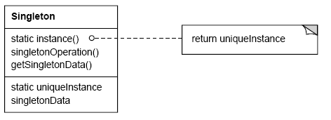
Singleton GoF Object Creational
Intent
Ensure a class only has one instance & provide a global point of access
Applicability
When there must be exactly one instance of a class & it must be accessible from a well-known access point
When the sole instance should be extensible by subclassing & clients should be able to use an extended instance without modifying their code
Structure
If (uniqueInstance == 0)
uniqueInstance = new Singleton;
return uniqueInstance;
e.g., Options & Reactor

Slide 249
Singleton GoF Object Creational
Singleton example in C++
Define a singleton class to handle command-line option processing
class Options {
public:
static Options *instance();
// Parse command-line arguments and sets values as follows:
// 't' - Traversal strategy, i.e., 'P' for pre-order, 'O' for
// post-order, 'I' for in-order, & 'L' for level-order.
bool parse_args(int argc, char *argv[]);
bool verbose() const; // True if program runs in verbose mode.
char traversal_strategy() // Returns desired traversal strategy.
...
private:
Options();
static Options *instance_;
...
if (instance_ == 0)
instance_ = new Options;
return instance_;
Accessor methods to check for enabled options
Make constructor private to prevent multiple instances
Points to the one & only instance

Slide 250
Singleton GoF Object Creational
Consequences
Reduces namespace pollution
Makes it easy to change your mind & allow more than one instance
Allow extension by subclassing
Same drawbacks of a global if misused
Implementation may be less efficient than a global
Concurrency/cache pitfalls & communication overhead
See c2.com/cgi/wiki?SingletonsAreEvil for discussion of Singleton issues

Slide 251
Singleton GoF Object Creational
Consequences
Reduces namespace pollution
Makes it easy to change your mind & allow more than one instance
Allow extension by subclassing
Same drawbacks of a global if misused
Implementation may be less efficient than a global
Concurrency/cache pitfalls & communication overhead
Implementation
Static instance operation
Registering singleton instance with manager
Deleting singletons
www.research.ibm.com/designpatterns/pubs/ph-jun96.txt: Singleton deletion

Slide 252
Singleton GoF Object Creational
Consequences
Reduces namespace pollution
Makes it easy to change your mind & allow more than one instance
Allow extension by subclassing
Same drawbacks of a global if misused
Implementation may be less efficient than a global
Concurrency/cache pitfalls & communication overhead
Implementation
Static instance operation
Registering singleton instance with manager
Deleting singletons
www.dre.vanderbilt.edu/~schmidt/PDF/ObjMan.pdf: Singleton management

Slide 253
Singleton GoF Object Creational
Consequences
Reduces namespace pollution
Makes it easy to change your mind & allow more than one instance
Allow extension by subclassing
Same drawbacks of a global if misused
Implementation may be less efficient than a global
Concurrency/cache pitfalls & communication overhead
Implementation
Static instance operation
Registering singleton instance with manager
Deleting singletons
Known Uses
Unidraw's Unidraw object
Smalltalk-80 ChangeSet, the set of changes to code
InterViews Session object
ACE Singleton
See Also
Double-Checked Locking Optimization pattern from POSA2 book
en.wikipedia.org/wiki/Double-checked_locking has more synchronization info

Slide 254
Summary of Application Structure Patterns
Reactor structures the overall control flow of the event-driven expression tree processing app & Singleton simplifies access to global resources
Reactor
Singleton
Reactor
Event_Handler
Options
ET_Command_Factory
ET_Event_Handler
ET_Context
<< create >>
Verbose_ET_ Event_Handler
Succinct_ET_ Event_Handler
ET_Command
The Reactor pattern embodies key characteristics of frameworks

Slide 255
A Case Study of “Gang of Four” (GoF) Patterns : Part 11
Douglas C. Schmidt
d.schmidt@vanderbilt.edu
www.dre.vanderbilt.edu/~schmidt
Professor of Computer Science
Institute for Software Integrated Systems Vanderbilt University Nashville, Tennessee, USA

Slide 256
Topics Covered in this Part of the Module
Describe the object-oriented (OO) expression tree case study
Evaluate the limitations with algorithmic design techniques
Present an OO design for the expression tree processing app
Summarize the patterns in the expression tree design
Explore patterns for
Tree structure & access
Tree creation
Tree traversal
Commands & factories
Command ordering protocols
Application structure
Encapsulating algorithm variability
Reactor
register_handler()
remove_handler()
run_event_loop()
end_event_loop()
Event_Handler
ET_Event_Handler
Verbose_ET_ Event_Handler
Succinct_ET_ Event_Handler

Slide 257
Overview of Algorithm Variability Encapsulation Patterns
Purpose: Simplify processing of multiple operation modes
Reactor
Event_Handler
Options
ET_Command_Factory
ET_Event_Handler
ET_Context
<< create >>
Verbose_ET_ Event_Handler
Succinct_ET_ Event_Handler
ET_Command
Strategy & Template Method
These patterns support controlled variability of steps in an algorithm

Slide 258
Problem: Supporting Multiple Operation Modes
Goals
Minimize effort required to support multiple modes of operation
e.g., verbose & succinct modes
% tree-traversal -v
format [in-order]
expr [expression]
print [in-order|pre-order|post- order|level-order]
eval [post-order]
quit
> format in-order
> expr 1+4*3/2
> eval post-order
7
> quit
% tree-traversal
> 1+4*3/2
7
Verbose mode
Succinct mode

Slide 259
Problem: Supporting Multiple Operation Modes
Goals
Minimize effort required to support multiple modes of operation
e.g., verbose & succinct mode
Constraints/forces
Don’t tightly couple the operation modes with the program structure
Simplify future enhancements
Avoid limitations of algorithmic decomposition

Slide 260
Solution A: Encapsulate Algorithm Variability
Implement algorithm once in base class & let subclasses define variant parts
Event_Handler
void handle_input() {
prompt_user();
std::string input;
if(!get_input(input))
Reactor::instance()->end_event_loop();
ET_Command command
= make_command(input);
if(!execute_command(command))
Reactor::instance()->end_event_loop();
}
ET_Event_Handler
handle_input()
prompt_user()
get_input()
make_command()
execute_command()

Slide 261
Solution A: Encapsulate Algorithm Variability
Implement algorithm once in base class & let subclasses define variant parts
Event_Handler
void handle_input() {
prompt_user();
std::string input;
if(!get_input(input))
Reactor::instance()->end_event_loop();
ET_Command command
= make_command(input);
if(!execute_command(command))
Reactor::instance()->end_event_loop();
}
ET_Event_Handler
handle_input()
prompt_user()
get_input()
make_command()
execute_command()
handle_input() is a template method
The other four methods are “hook methods”

Slide 262
Solution A: Encapsulate Algorithm Variability
Implement algorithm once in base class & let subclasses define variant parts
Event_Handler
void handle_input() {
prompt_user();
std::string input;
if(!get_input(input))
Reactor::instance()->end_event_loop();
ET_Command command
= make_command(input);
if(!execute_command(command))
Reactor::instance()->end_event_loop();
}
ET_Event_Handler
handle_input()
prompt_user()
get_input()
make_command()
execute_command()
Verbose_ET_ Event_Handler
prompt_user()
make_command()
Succinct_ET_ Event_Handler
prompt_user()
make_command()

Slide 263
Solution A: Encapsulate Algorithm Variability
Implement algorithm once in base class & let subclasses define variant parts
Event_Handler
void handle_input() {
prompt_user();
std::string input;
if(!get_input(input))
Reactor::instance()->end_event_loop();
ET_Command command
= make_command(input);
if(!execute_command(command))
Reactor::instance()->end_event_loop();
}
ET_Event_Handler
handle_input()
prompt_user()
get_input()
make_command()
execute_command()
Verbose_ET_ Event_Handler
prompt_user()
make_command()
Succinct_ET_ Event_Handler
prompt_user()
make_command()
ET_Command make_command
(const std::string &input) {
return command_factory_. make_macro_command(input);
}
ET_Command make_command
(const std::string &input) { return command_factory_.make_command(input); }
Customized hook methods

Slide 264
ET_Event_Handler Class Interface
Provides an abstract interface for performing the algorithm associated with the expression tree processing app
Template method
Interface
Factory
virtual void | handle_input()
static ET_Event_Handler * | make_handler(bool verbose)
virtual void | prompt_user()=0
virtual bool | get_input(std::string &)
virtual ET_Command | make_command(const std::string &input)=0
virtual bool | execute_command(ET_Command &)
Hook methods
Commonality: Provides a common interface for handling user input events & performing steps in the expression tree processing algorithm
Variability: Subclasses implement various operation modes, e.g., verbose vs. succinct mode

Slide 265
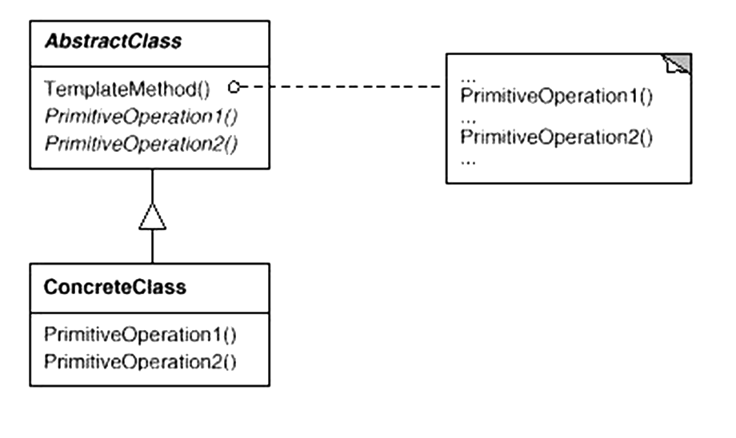
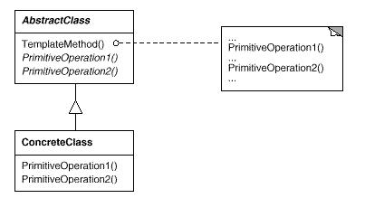
Template Method GoF Class Behavioral
Intent
Provide a skeleton of an algorithm in a method, deferring some steps to subclasses
Applicability
Implement invariant aspects of an algorithm once & let subclasses define variant parts
Localize common behavior in a class to increase code reuse
Control subclass extensions
Structure
e.g., ET_Event_Handler
e.g., Verbose_ET_Event _Handler, Succinct_ ET_Event_Handler

Slide 266
Template Method GoF Class Behavioral
Template Method example in C++
Allow subclasses to customize certain steps in event handling algorithm
void ET_Event_Handler::handle_input() {
prompt_user();
std::string input;
if (!get_input(input)) Reactor::instance()->end_event_loop();
ET_Command command = make_command(input);
if (!execute_command(command)) Reactor::instance()->end_event_loop();
...
Template method
Hook methods

Slide 267
Template Method GoF Class Behavioral
Template Method example in C++
Allow subclasses to customize certain steps in event handling algorithm
void ET_Event_Handler::handle_input() {
prompt_user();
std::string input;
if (!get_input(input)) Reactor::instance()->end_event_loop();
ET_Command command = make_command(input);
if (!execute_command(command)) Reactor::instance()->end_event_loop();
...
ET_Command Verbose_ET_Event_Handler::make_command (const std::string &input) {
return command_factory_.make_command(input);
}
Specialized hook methods
ET_Command Succinct_ET_Event_Handler::make_command (const std::string &input) {
return command_factory_.make_macro_command(input);
}

Slide 268
Template Method GoF Class Behavioral
Template Method example in C++
Allow subclasses to customize certain steps in event handling algorithm
void ET_Event_Handler::handle_input() {
prompt_user();
std::string input;
if (!get_input(input)) Reactor::instance()->end_event_loop();
ET_Command command = make_command(input);
if (!execute_command(command)) Reactor::instance()->end_event_loop();
...
ET_Event_Handler *ET_Event_Handler::make_handler(bool verbose) {
return verbose ? new Verbose_ET_Event_Handler
: new Succint_ET_Event_Handler
}
Factory creates appropriate strategy objects
This is not the only (or best) way of defining a factory

Slide 269
Template Method GoF Class Behavioral
Consequences
Enables inversion of control (“Hollywood principle: don't call us – we'll call you!”)
Promotes code reuse
Lets you enforce overriding rules
Must subclass to specialize behavior (cf. Strategy pattern)

Slide 270
Template Method GoF Class Behavioral
Consequences
Enables inversion of control (“Hollywood principle: don't call us – we'll call you!”)
Promotes code reuse
Lets you enforce overriding rules
Must subclass to specialize behavior (cf. Strategy pattern)
Implementation
Virtual vs. non-virtual template method
Few vs. many primitive operations (hook methods)
Naming conventions (do_*() vs. make_*() prefix)

Slide 271
Template Method GoF Class Behavioral
Consequences
Enables inversion of control (“Hollywood principle: don't call us – we'll call you!”)
Promotes code reuse
Lets you enforce overriding rules
Must subclass to specialize behavior (cf. Strategy pattern)
Implementation
Virtual vs. non-virtual template method
Few vs. many primitive operations (hook methods)
Naming conventions (do_*() vs. make_*() prefix)
Known Uses
InterViews Kits
ET++ WindowSystem
AWT Toolkit
ACE & The ACE ORB (TAO)
Android Activities

Slide 272
Solution B: Encapsulate Algorithm Variability
Implement algorithm once in base class & let strategies define variant parts
Event_Handler
void handle_input() { prompt_user();
std::string input;
if(!get_input(input))
Reactor::instance() ->end_event_loop();
ET_Command cmd
= make_command(input);
if(!execute_command(cmd)) Reactor::instance() ->end_event_loop();
}
ET_Event_Handler
handle_input()
Same template method & hook methods as before

Slide 273
Solution B: Encapsulate Algorithm Variability
Implement algorithm once in base class & let strategies define variant parts
Event_Handler
void handle_input() { prompt_user();
std::string input;
if(!get_input(input))
Reactor::instance() ->end_event_loop();
ET_Command cmd
= make_command(input);
if(!execute_command(cmd)) Reactor::instance() ->end_event_loop();
}
PROMPT_USER _STRATEGY
ET_Event_Handler
handle_input()
GET_INPUT _STRATEGY
PROMPT_USER_STRATEGY, GET_INPUT_STRATEGY, MAKE_COMMAND_STRATEGY, EXECUTE_COMMAND_STRATEGY
MAKE_ COMMAND _STRATEGY
Strategy_ET_ Event_Handler
handle_input()
prompt_user()
get_input()
make_command()
execute_command()
EXECUTE_ COMMAND _STRATEGY
Strategy objects can be passed as arguments to Strategy_ET_Event_Handler constructor
Strategy objects can be defined using C++ parameterized types

Slide 274
Solution B: Encapsulate Algorithm Variability
Implement algorithm once in base class & let strategies define variant parts
Event_Handler
void handle_input() { prompt_user();
std::string input;
if(!get_input(input))
Reactor::instance() ->end_event_loop();
ET_Command cmd
= make_command(input);
if(!execute_command(cmd)) Reactor::instance() ->end_event_loop();
}
PROMPT_USER _STRATEGY
ET_Event_Handler
handle_input()
GET_INPUT _STRATEGY
PROMPT_USER_STRATEGY, GET_INPUT_STRATEGY, MAKE_COMMAND_STRATEGY, EXECUTE_COMMAND_STRATEGY
MAKE_ COMMAND _STRATEGY
Strategy_ET_ Event_Handler
handle_input()
prompt_user()
get_input()
make_command()
execute_command()
EXECUTE_ COMMAND _STRATEGY
Hook methods forward to strategy object methods
ET_Command make_command(const std::string &input) { return mc_strategy_.make_command(input); }
bool execute_command(const std::string &input) { return ec_strategy_.execute_command(input); }

Slide 275
Strategy Template Parameters
Provides template parameters that perform steps in the algorithm associated with the expression tree processing app
Template Parameters
MAKE_COMMAND _STRATEGY
ET_Command | make_command(const std::string &input)
EXECUTE_COMMAND _STRATEGY
bool | execute_command(const std::string &input) ...
Expected method signatures
Commonality: Provides common expected method signatures for performing steps in the expression tree processing algorithm
Variability: Template arguments provided to Strategy_ET_Event _Handler implement various operation modes, e.g., verbose vs. succinct

Slide 276
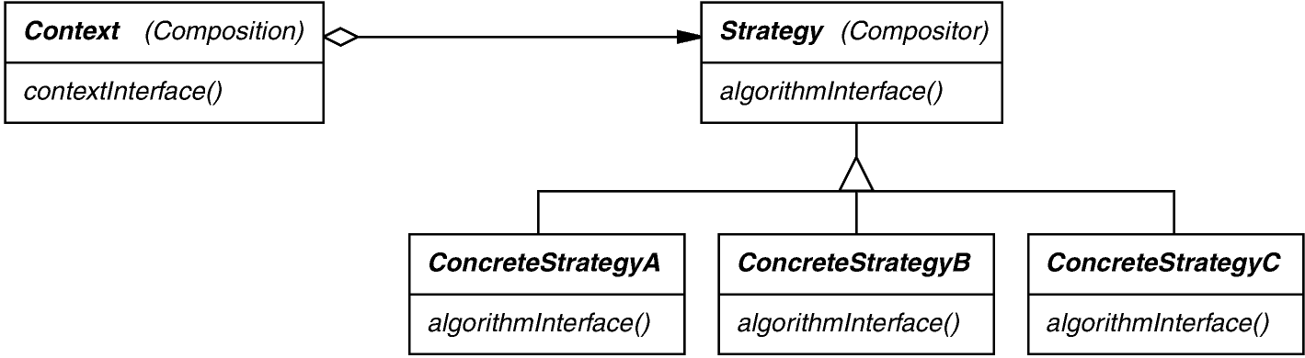
Strategy GoF Object Behavioral
Intent
Define a family of algorithms, encapsulate each one, & make them interchangeable to let clients & algorithms vary independently
Applicability
When an object should be configurable with one of many algorithms,
and all algorithms can be encapsulated,
and one interface covers all encapsulations
Structure
e.g., MAKE_COMMAND_ STRATEGY, EXECUTE_ COMMAND_STRATEGY, etc.

Slide 277
Strategy GoF Object Behavioral
Strategy example in C++
Customize algorithm behavior by composition/forwarding vs. inheritance
template <..., typename MAKE_COMMAND_STRATEGY, typename EXECUTE_COMMAND_STRATEGY> class Strategy_ET_Event_Handler : public ET_Event_Handler {
public:
Strategy_ET_Event_Handler (..., const MAKE_COMMAND_STRATEGY &mc_strategy,
const EXECUTE_COMMAND_STRATEGY &ec_strategy) ...
Parameterized type strategies
Reuse handle_input() template method
Pass strategy objects via constructor & assign to corresponding data members
Note combination of Template Method & Strategy patterns

Slide 278
Strategy GoF Object Behavioral
Strategy example in C++
Customize algorithm behavior by composition/forwarding vs. inheritance
template <..., typename MAKE_COMMAND_STRATEGY, typename EXECUTE_COMMAND_STRATEGY> class Strategy_ET_Event_Handler : public ET_Event_Handler {
public:
Strategy_ET_Event_Handler (..., const MAKE_COMMAND_STRATEGY &mc_strategy,
const EXECUTE_COMMAND_STRATEGY &ec_strategy) ...
...
ET_Command make_command(const std::string &user_input) { return mc_strategy_.make_command(user_input); }
bool execute_command(ET_Command &command) { return ec_strategy_.execute_command(command); }
Hook methods forward to strategy objects

Slide 279
Strategy GoF Object Behavioral
Strategy example in C++
Customize algorithm behavior by composition/forwarding vs. inheritance
template <..., typename MAKE_COMMAND_STRATEGY, typename EXECUTE_COMMAND_STRATEGY> class Strategy_ET_Event_Handler : public ET_Event_Handler {
public:
Strategy_ET_Event_Handler (..., const MAKE_COMMAND_STRATEGY &mc_strategy,
const EXECUTE_COMMAND_STRATEGY &ec_strategy) ...
...
class Macro_Command_Strategy { public: ... ET_Command make_command(const std::string &input)
{ return command_factory_.make_macro_command(input); } };
Will be used as argument to the Strategy_ET_Event_Handler parameterized type
Creates a macro command

Slide 280
Strategy GoF Object Behavioral
Strategy example in C++
Customize algorithm behavior by composition/forwarding vs. inheritance
template <..., typename MAKE_COMMAND_STRATEGY, typename EXECUTE_COMMAND_STRATEGY> class Strategy_ET_Event_Handler : public ET_Event_Handler {
public:
Strategy_ET_Event_Handler (..., const MAKE_COMMAND_STRATEGY &mc_strategy,
const EXECUTE_COMMAND_STRATEGY &ec_strategy) ...
...
ET_Event_Handler *Strategy_ET_Event_Handler::make_handler (bool verbose) {
return verbose ? new Strategy_ET_Event_Handler
<..., Command_Strategy, ...>
: new Strategy_ET_Event_Handler
<..., Macro_Command_Strategy, ...>
}
Factory creates appropriate strategy objects

Slide 281
Strategy GoF Object Behavioral
Consequences
Greater flexibility, reuse
Can change algorithms dynamically
Strategy creation & communication overhead
Inflexible Strategy interface
Semantic incompatibility of multiple strategies used together

Slide 282
Strategy GoF Object Behavioral
Consequences
Greater flexibility, reuse
Can change algorithms dynamically
Strategy creation & communication overhead
Inflexible strategy interface
Semantic incompatibility of multiple strategies used together
Implementation
Exchanging information between a strategy & its context
Context is not always necessary
Static binding of strategy selection via parameterized types

Slide 283
Strategy GoF Object Behavioral
Consequences
Greater flexibility, reuse
Can change algorithms dynamically
Strategy creation & communication overhead
Inflexible strategy interface
Semantic incompatibility of multiple strategies used together
Implementation
Exchanging information between a strategy & its context
Context is not always necessary
Static binding of strategy selection via parameterized types
Known Uses
InterViews text formatting
RTL register allocation & scheduling strategies
ET++SwapsManager calculation engines
The ACE ORB (TAO) real-time object request broker middleware
See Also
Bridge pattern (object structural)

Slide 284
Comparing Strategy with Template Method
Strategy
Provides for clean separation between components via “black-box” interfaces
Allows for strategy composition at runtime
Supports flexible mixing & matching of features
Incurs the overhead of forwarding
May yield many strategy classes

Slide 285
Comparing Strategy with Template Method
Strategy
Provides for clean separation between components via “black-box” interfaces
Allows for strategy composition at runtime
Supports flexible mixing & matching of features
Incurs the overhead of forwarding
May yield many strategy classes
Template Method
No explicit forwarding necessary
May be easier for small use cases
Close coupling between subclass(es) & base class
Inheritance hierarchies are static & cannot be reconfigured at runtime
Adding features via inheritance may yield combinatorial subclass explosion
Beware overusing inheritance since it’s not always the best choice
Deep inheritance hierarchies in an app are a red flag
Strategy is commonly used for Black-box frameworks
Template Method is commonly used for White-box frameworks

Slide 286
Overview of Algorithm Variability Encapsulation Patterns
The Strategy & Template Method patterns simplify processing of multiple operation modes
Reactor
Event_Handler
Options
ET_Command_Factory
ET_Event_Handler
ET_Context
<< create >>
Verbose_Expression_
Tree_Event_Handler
Macro_Expression_
Tree_Event_Handler
ET_Command
Strategy & Template Method
These patterns avoid limitations of algorithmic decomposition

Slide 287
Summary
Pattern-oriented expression tree processing app design has many benefits:
Major improvements over the original algorithmic decomposition
Expression_Tree
Component_Node
Composite_
Unary_Node
Leaf_Node
Composite_Binary _Node
Composite_Negate _Node
1
Composite_
Add_Node
Composite_
Subtract_Node
Tree Node
Composite_
Multiply_Node
Composite_
Divide_Node
0|1|2

Slide 288
Summary
Pattern-oriented expression tree processing app design has many benefits:
Major improvements over the original algorithmic decomposition
Much more modular & extensible
Expression_Tree
Component_Node
Composite_
Unary_Node
Leaf_Node
Composite_Binary _Node
Composite_Negate _Node
1
Composite_
Add_Node
Composite_
Subtract_Node
Tree Node
Composite_
Multiply_Node
Composite_
Divide_Node
0|1|2

Slide 289
Summary
Pattern-oriented expression tree processing app design has many benefits:
Major improvements over the original algorithmic decomposition
Much more modular & extensible
Design matches the “domain” better
Expression_Tree
Component_Node
Composite_
Unary_Node
Leaf_Node
Composite_Binary _Node
Composite_Negate _Node
1
Composite_
Add_Node
Composite_
Subtract_Node
Tree Node
Composite_
Multiply_Node
Composite_
Divide_Node
0|1|2

Slide 290
Summary
Pattern-oriented expression tree processing app design has many benefits:
Major improvements over the original algorithmic decomposition
Much more modular & extensible
Design matches the “domain” better
Less space overhead
Expression_Tree
Component_Node
Composite_
Unary_Node
Leaf_Node
Composite_Binary _Node
Composite_Negate _Node
1
Composite_
Add_Node
Composite_
Subtract_Node
Tree Node
Composite_
Multiply_Node
Composite_
Divide_Node
0|1|2
Koenig’s Ruminations on C++ book has another OO expression tree example

Slide 291
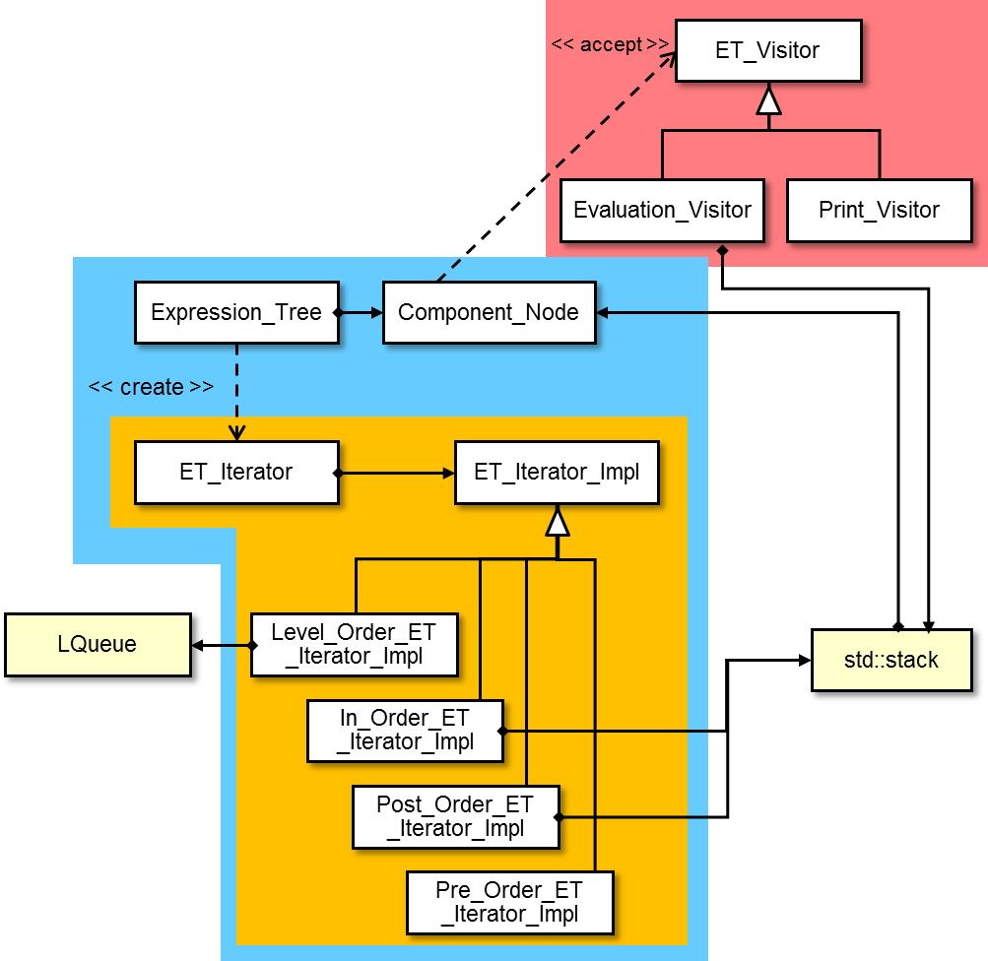
Summary
Visitor
Pattern-oriented expression tree processing app design has many benefits:
Major improvement over the original algorithmic decomposition
Exhibits “high pattern density”
Iterator
Prototype

Slide 292
Summary
Visitor
Pattern-oriented expression tree processing app design has many benefits:
Major improvement over the original algorithmic decomposition
Exhibits “high pattern density”
Nearly all classes & objects in design play a role in one or more patterns
Iterator
Prototype

Slide 293
Summary
Visitor
Pattern-oriented expression tree processing app design has many benefits:
Major improvement over the original algorithmic decomposition
Exhibits “high pattern density”
Nearly all classes & objects in design play a role in one or more patterns
Patterns help clarify the relationships of myriad classes in the design
Iterator
Prototype

Slide 294
Summary
Pattern-oriented expression tree processing app design has many benefits:
Major improvement over the original algorithmic decomposition
Exhibits “high pattern density”
Same design can easily be realized in common OO programming languages
Expression_Tree expr_tree = ...; Print_Visitor print_visitor;
for (auto &iter : expr_tree)
iter.accept(print_visitor);
ExpressionTree exprTree = ...;
ETVisitor printVisitor = new PrintVisitor();
for (ComponentNode node : exprTree)
node.accept(printVisitor);
C++11 range-based for loop
Java for-each loop

Slide 295
Summary
Pattern-oriented expression tree processing app design has many benefits:
Major improvement over the original algorithmic decomposition
Exhibits “high pattern density”
Same design can easily be realized in common OO programming languages
C++ & Java solutions are nearly identical, modulo minor syntactical & semantic differences
Expression_Tree expr_tree = ...; Print_Visitor print_visitor;
for (auto &iter : expr_tree)
iter.accept(print_visitor);
ExpressionTree exprTree = ...;
ETVisitor printVisitor = new PrintVisitor();
for (ComponentNode node : exprTree)
node.accept(printVisitor);
C++11 range-based for loop
Java for-each loop
See www.vincehuston.org/dp for many examples of patterns in C++ & Java

